Slide 1
Database Programming Chapter 4: Basic SQL

Slide 2
Chapter Outline
Data Definition, Constraints, and Schema Changes
CREATE, DROP, and ALTER the descriptions of the tables (relations) of a database
Referential Integrity Options
Retrieval Queries in SQL
SELECT <attribute list> FROM <table list> [WHERE <condition>]
[ORDER BY <attribute list>]
Specifying Updates in SQL
INSERT, DELETE, and UPDATE

Slide 3
Introduction
SQL: Structured Query Language

Slide 4
Create Schema
SQL schema definition
Schema name
Authorization identifier
CREATE SCHEMA Company AUTHORIZATION ‘Jsmith’

Slide 5
CREATE TABLE
Specifies a new base relation by giving it a name, and specifying each of its attributes and their data types (INTEGER, FLOAT, DECIMAL(i,j), CHAR(n), VARCHAR(n))
A constraint NOT NULL may be specified on an attribute CREATE TABLE DEPARTMENT ( DNAME VARCHAR(10) NOT NULL, DNUMBER INTEGER NOT NULL, MGRSSN CHAR(9), MGRSTARTDATE CHAR(9) );
CREATE TABLE COMPANY.DEPARTMENT ( DNAME VARCHAR(10) NOT NULL, DNUMBER INTEGER NOT NULL, MGRSSN CHAR(9), MGRSTARTDATE CHAR(9) );

Slide 6
DROP TABLE
Used to remove a relation (base table) and its definition
The relation can no longer be used in queries, updates, or any other commands since its description no longer exists
Example: DROP TABLE DEPENDENT;

Slide 7
ALTER TABLE
Used to add an attribute to one of the base relations
The new attribute will have NULLs in all the tuples of the relation right after the command is executed; hence, the NOT NULL constraint is not allowed for such an attribute
Example: ALTER TABLE EMPLOYEE ADD JOB VARCHAR(12);
The database users must still enter a value for the new attribute JOB for each EMPLOYEE tuple.
This can be done using the UPDATE command.

Slide 8
SQL Data Types
Numeric
INT, SMALLINT, DECIMAL(I,j)
Character string
CHAR(n), VARCHAR(n)
Bit- string
BIT(n)
Date
Made up of year-month-day in the format yyyy-mm-dd
Time
Made up of hour:minute:second in the format hh:mm:ss
Timestamp
Include the date and time fields
Boolean

Slide 9
Constrains in SQL
Create domain
CREATE DOMAIN SSN_TYPE AS CHAR(10)
NOT NULL
UNIQUE
Used to define secondary keys
DEFAULT
Append the clause DEFAULT <value> after an attribute definition.
Dnumber INT NOT NULL DEFAULT 1;
CHECK
Used to restrict attribute or domain values
Dnumber INT NOT NULL CHECK (Dnumber > 0 AND Dnumber < 21);

Slide 10
Constrains in SQL
Primary key constrain
Foreign key constrains
CREATE TABLE DEPT (
DNAME VARCHAR(10) NOT NULL,
DNUMBER INTEGER NOT NULL,
MGRSSN CHAR(9),
MGRSTARTDATE CHAR(9),
PRIMARY KEY (DNUMBER),
FOREIGN KEY (MGRSSN) REFERENCES EMP );

Slide 11
REFERENTIAL INTEGRITY OPTIONS
We can specify RESTRICT, CASCADE, SET NULL or SET DEFAULT on referential integrity constraints (foreign keys)
CREATE TABLE DEPT ( DNAME VARCHAR(10) NOT NULL, DNUMBER INTEGER NOT NULL, MGRSSN CHAR(9) DEFAULT 0, MGRSTARTDATE CHAR(9), PRIMARY KEY (DNUMBER), UNIQUE (DNAME), FOREIGN KEY (MGRSSN) REFERENCES EMP ON DELETE SET DEFAULT ON UPDATE CASCADE);

Slide 12
REFERENTIAL INTEGRITY OPTIONS (continued)
CREATE TABLE EMP( ENAME VARCHAR(30) NOT NULL, ESSN CHAR(9), BDATE DATE, DNO INTEGER DEFAULT 1, SUPERSSN CHAR(9), PRIMARY KEY (ESSN), FOREIGN KEY (DNO) REFERENCES DEPT ON DELETE SET DEFAULT ON UPDATE CASCADE, FOREIGN KEY (SUPERSSN) REFERENCES EMP ON DELETE SET NULL ON UPDATE CASCADE);

Slide 13
Retrieval Queries in SQL
Basic form of the SQL SELECT statement is called
a mapping or a SELECT-FROM-WHERE block
SELECT <attribute list>
FROM <table list>
WHERE <condition>
<attribute list> is a list of attribute names whose
values are to be retrieved by the query
<table list> is a list of the relation names required to
process the query
<condition> is a conditional (Boolean) expression that
identifies the tuples to be retrieved by the query

Slide 14
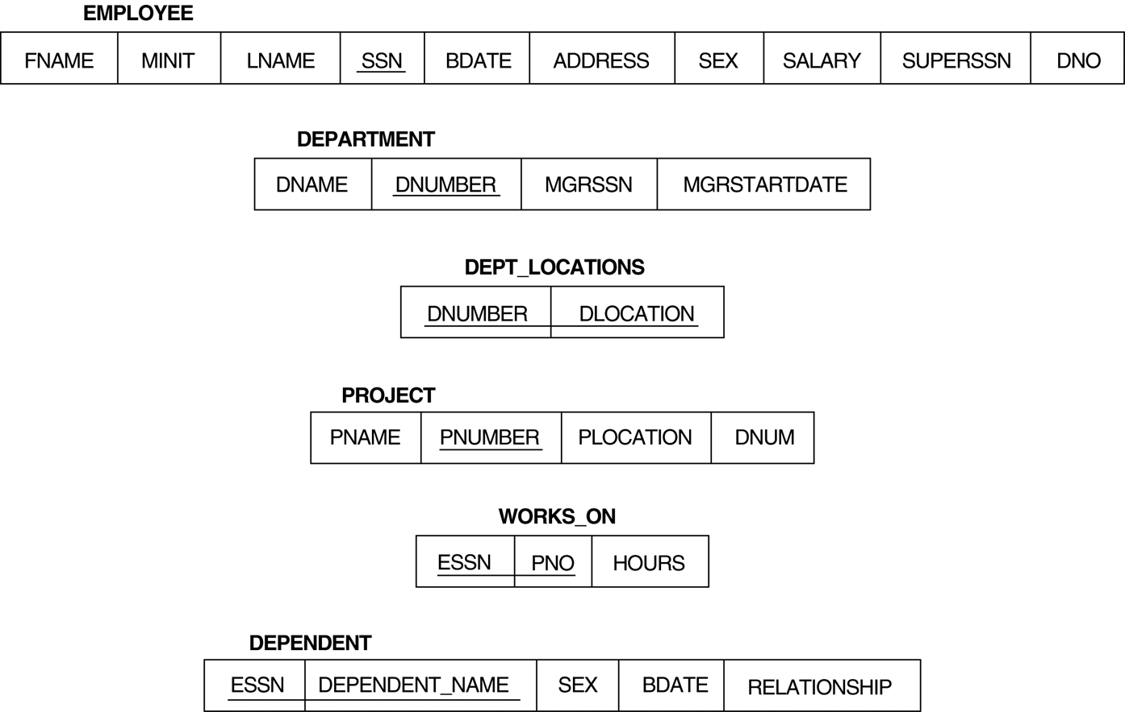
Relational Database Schema

Slide 15
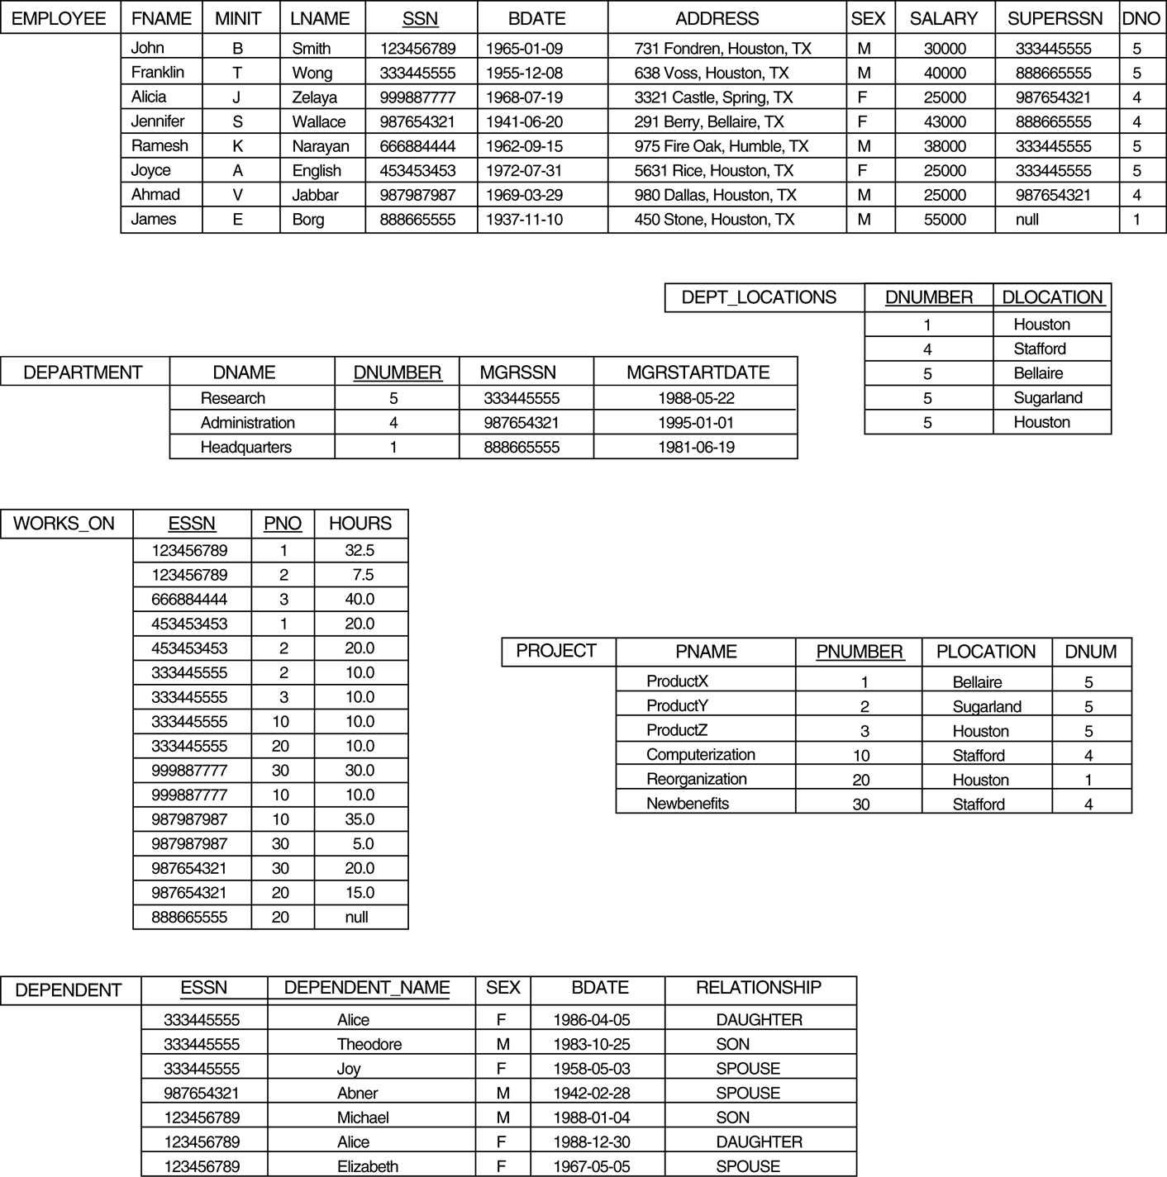
Populated Database

Slide 16
Simple SQL Queries
Example of a simple query on one relation
Query 0: Retrieve the birthdate and address of the employee whose name is 'John B. Smith'.
Q0:SELECT BDATE, ADDRESS FROM EMPLOYEE WHERE FNAME='John' AND MINIT='B’ AND LNAME='Smith’
The SELECT-clause specifies the projection attributes and the WHERE-clause specifies the selection condition
However, the result of the query may contain duplicate tuples

Slide 17
Simple SQL Queries (contd.)
Query 1: Retrieve the name and address of all employees who work for the 'Research' department.
Q1: SELECT FNAME, LNAME, ADDRESS FROM EMPLOYEE, DEPARTMENT WHERE DNAME='Research' AND DNUMBER=DNO
(DNAME='Research') is a selection condition
(DNUMBER=DNO) is a join condition

Slide 18
Simple SQL Queries (contd.)
Query 2: For every project located in 'Stafford', list the project number, the controlling department number, and the department manager's last name, address, and birthdate.
Q2: SELECT PNUMBER, DNUM, LNAME, BDATE, ADDRESS FROM PROJECT, DEPARTMENT, EMPLOYEE WHERE DNUM=DNUMBER AND MGRSSN=SSN AND PLOCATION='Stafford'
In Q2, there are two join conditions
The join condition DNUM=DNUMBER relates a project to its controlling department
The join condition MGRSSN=SSN relates the controlling department to the employee who manages that department

Slide 19
Aliases, * and DISTINCT, Empty WHERE-clause
In SQL, we can use the same name for two (or more) attributes as long as the attributes are in different relations
A query that refers to two or more attributes with the same name must qualify the attribute name with the relation name by prefixing the relation name to the attribute name
Example:
EMPLOYEE.LNAME, DEPARTMENT.DNAME

Slide 20
ALIASES
Some queries need to refer to the same relation twice
In this case, aliases are given to the relation name
Query 8: For each employee, retrieve the employee's name, and the name of his or her immediate supervisor. Q8: SELECT E.FNAME, E.LNAME, S.FNAME, S.LNAME FROM EMPLOYEE E S WHERE E.SUPERSSN=S.SSN
In Q8, the alternate relation names E and S are called aliases or tuple variables for the EMPLOYEE relation
We can think of E and S as two different copies of EMPLOYEE; E represents employees in role of supervisees and S represents employees in role of supervisors

Slide 21
ALIASES (contd.)
Can also use the AS keyword to specify aliases
Q8: SELECT E.FNAME, E.LNAME, S.FNAME, S.LNAME FROM EMPLOYEE AS E, EMPLOYEE AS S WHERE E.SUPERSSN=S.SSN

Slide 22
UNSPECIFIED WHERE-clause
A missing WHERE-clause indicates no condition; hence, all tuples of the relations in the FROM-clause are selected
This is equivalent to the condition WHERE TRUE
Query 9: Retrieve the SSN values for all employees.
Q9: SELECT SSN FROM EMPLOYEE
If more than one relation is specified in the FROM-clause and there is no join condition, then the CARTESIAN PRODUCT of tuples is selected

Slide 23
UNSPECIFIED WHERE-clause (contd.)
Example:
Q10: SELECT SSN, DNAME FROM EMPLOYEE, DEPARTMENT
It is extremely important not to overlook specifying any selection and join conditions in the WHERE-clause; otherwise, incorrect and very large relations may result

Slide 24
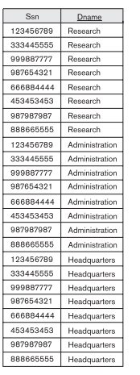

Slide 25
USE OF *
To retrieve all the attribute values of the selected tuples, a * is used, which stands for all the attributes Examples:
Q1C: SELECT * FROM EMPLOYEE WHERE DNO=5 Q1D: SELECT * FROM EMPLOYEE, DEPARTMENT WHERE DNAME='Research' AND DNO=DNUMBER

Slide 26
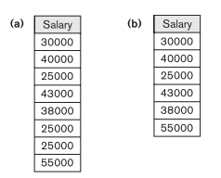
USE OF DISTINCT
SQL does not treat a relation as a set; duplicate tuples can appear
To eliminate duplicate tuples in a query result, the keyword DISTINCT is used
For example, the result of Q11 may have duplicate SALARY values whereas Q11A does not have any duplicate values
Q11: SELECT SALARY FROM EMPLOYEE Q11A: SELECT DISTINCT SALARY FROM EMPLOYEE

Slide 27
SET OPERATIONS
SQL has directly incorporated some set operations
There is a union operation (UNION), and in some versions of SQL there are set difference (MINUS) and intersection (INTERSECT) operations
The resulting relations of these set operations are sets of tuples; duplicate tuples are eliminated from the result
The set operations apply only to union compatible relations; the two relations must have the same attributes and the attributes must appear in the same order

Slide 28
SET OPERATIONS (contd.)
Query 4: Make a list of all project numbers for projects that involve an employee whose last name is 'Smith' as a worker or as a manager of the department that controls the project.
Q4: (SELECT PNAME FROM PROJECT, DEPARTMENT, EMPLOYEE WHERE DNUM=DNUMBER AND MGRSSN=SSN AND LNAME='Smith') UNION
(SELECT PNAME FROM PROJECT, WORKS_ON, EMPLOYEE WHERE PNUMBER=PNO AND
ESSN=SSN AND NAME='Smith')

Slide 29
String Pattern Matching
Partial strings are specified using two reserved characters:
% replaces an arbitrary number of zero or more characters,
the underscore (_) replaces a single character
Query 12. Retrieve all employees whose address is in Houston,Texas.
SELECT Fname, Lname
FROM EMPLOYEE
WHERE Address LIKE ‘%Houston,TX%’;

Slide 30
String Pattern Matching
Query 12A. Find all employees who were born during the 1950s.
SELECT Fname, Lname
FROM EMPLOYEE
WHERE Bdate LIKE ‘195 _ _ _ _ _ _ _’;

Slide 31
ORDER BY
The ORDER BY clause is used to sort the tuples in a query result based on the values of some attribute(s)
Query 28: Retrieve a list of employees and the projects each works in, ordered by the employee's department, and within each department ordered alphabetically by employee last name.
Q28: SELECT DNAME, LNAME, FNAME, PNAME FROM DEPARTMENT, EMPLOYEE, WORKS_ON, PROJECT WHERE DNUMBER=DNO AND SSN=ESSN AND PNO=PNUMBER ORDER BY DNAME, LNAME

Slide 32
ORDER BY (contd.)
The default order is in ascending order of values
We can specify the keyword DESC if we want a descending order; the keyword ASC can be used to explicitly specify ascending order, even though it is the default

Slide 33
Summary of SQL Queries
A query in SQL can consist of up to six clauses, but only the first two, SELECT and FROM, are mandatory. The clauses are specified in the following order: SELECT <attribute list> FROM <table list> [WHERE <condition>] [ORDER BY <attribute list>]

Slide 34
Summary of SQL Queries (contd.)
The SELECT-clause lists the attributes or functions to be retrieved
The FROM-clause specifies all relations (or aliases) needed in the query but not those needed in nested queries
The WHERE-clause specifies the conditions for selection and join of tuples from the relations specified in the FROM-clause
ORDER BY specifies an order for displaying the result of a query
A query is evaluated by first applying the WHERE-clause, then GROUP BY and HAVING, and finally the SELECT-clause

Slide 35
Specifying Updates in SQL
There are three SQL commands to modify the database: INSERT, DELETE, and UPDATE

Slide 36
INSERT
In its simplest form, it is used to add one or more tuples to a relation
Attribute values should be listed in the same order as the attributes were specified in the CREATE TABLE command

Slide 37
INSERT (contd.)
Example:
U1: INSERT INTO EMPLOYEE VALUES ('Richard','K','Marini', '653298653', '30-DEC-52', '98 Oak Forest,Katy,TX', 'M', 37000,'987654321', 4 )
An alternate form of INSERT specifies explicitly the attribute names that correspond to the values in the new tuple
Attributes with NULL values can be left out
Example: Insert a tuple for a new EMPLOYEE for whom we only know the FNAME, LNAME, and SSN attributes.
U1A: INSERT INTO EMPLOYEE (FNAME, LNAME, SSN) VALUES ('Richard', 'Marini', '653298653')

Slide 38
INSERT (contd.)
Important Note: Only the constraints specified in the DDL commands are automatically enforced by the DBMS when updates are applied to the database
Another variation of INSERT allows insertion of multiple tuples resulting from a query into a relation

Slide 39
INSERT (contd.)
Example: Suppose we want to create a temporary table that has the name, number of employees, and total salaries for each department.
A table DEPTS_INFO is created by U3A, and is loaded with the summary information retrieved from the database by the query in U3B.
U3A: CREATE TABLE DEPTS_INFO (DEPT_NAME VARCHAR(10), NO_OF_EMPS INTEGER, TOTAL_SAL INTEGER);
U3B: INSERT INTO DEPTS_INFO (DEPT_NAME, NO_OF_EMPS, TOTAL_SAL) SELECT DNAME, COUNT (*), SUM (SALARY) FROM DEPARTMENT, EMPLOYEE WHERE DNUMBER=DNO GROUP BY DNAME ;

Slide 40
INSERT (contd.)
Note: The DEPTS_INFO table may not be up-to-date if we change the tuples in either the DEPARTMENT or the EMPLOYEE relations after issuing U3B. We have to create a view (see later) to keep such a table up to date.

Slide 41
DELETE
Removes tuples from a relation
Includes a WHERE-clause to select the tuples to be deleted
Referential integrity should be enforced
Tuples are deleted from only one table at a time (unless CASCADE is specified on a referential integrity constraint)
A missing WHERE-clause specifies that all tuples in the relation are to be deleted; the table then becomes an empty table
The number of tuples deleted depends on the number of tuples in the relation that satisfy the WHERE-clause

Slide 42
DELETE (contd.)
Examples:
U4A: DELETE FROM EMPLOYEE WHERE LNAME='Brown’
U4B: DELETE FROM EMPLOYEE WHERE SSN='123456789’
U4C: DELETE FROM EMPLOYEE WHERE DNO IN (SELECT DNUMBER FROM DEPARTMENT WHERE DNAME='Research')
U4D: DELETE FROM EMPLOYEE

Slide 43
UPDATE
Used to modify attribute values of one or more selected tuples
A WHERE-clause selects the tuples to be modified
An additional SET-clause specifies the attributes to be modified and their new values
Each command modifies tuples in the same relation
Referential integrity should be enforced

Slide 44
UPDATE (contd.)
Example: Change the location and controlling department number of project number 10 to 'Bellaire' and 5, respectively.
U5: UPDATE PROJECT SET PLOCATION = 'Bellaire', DNUM = 5 WHERE PNUMBER=10

Slide 45
UPDATE (contd.)
Example: Give all employees in the 'Research' department a 10% raise in salary.
U6: UPDATE EMPLOYEE SET SALARY = SALARY *1.1 WHERE DNO IN (SELECT DNUMBER FROM DEPARTMENT WHERE DNAME='Research')
In this request, the modified SALARY value depends on the original SALARY value in each tuple
The reference to the SALARY attribute on the right of = refers to the old SALARY value before modification
The reference to the SALARY attribute on the left of = refers to the new SALARY value after modification

Slide 46
Recap of SQL Queries
A query in SQL can consist of up to six clauses, but only the first two, SELECT and FROM, are mandatory. The clauses are specified in the following order: SELECT <attribute list> FROM <table list> [WHERE <condition>] [ORDER BY <attribute list>]
There are three SQL commands to modify the database: INSERT, DELETE, and UPDATE

