Slide 1
Algorithms Design and Analysis- 2
Linear Programming
Mayada Hadhoud
Computer Engineering Department
Cairo University
Fall 2016

Slide 2
General Linear Programming Problem
It is the problem of either maximizing or minimizing a linear function subject to a finite set of linear constraints.
If we are to minimize, then we call the linear program a minimization linear program, and if we are to maximize, then we call the linear program a maximization linear program

Slide 3
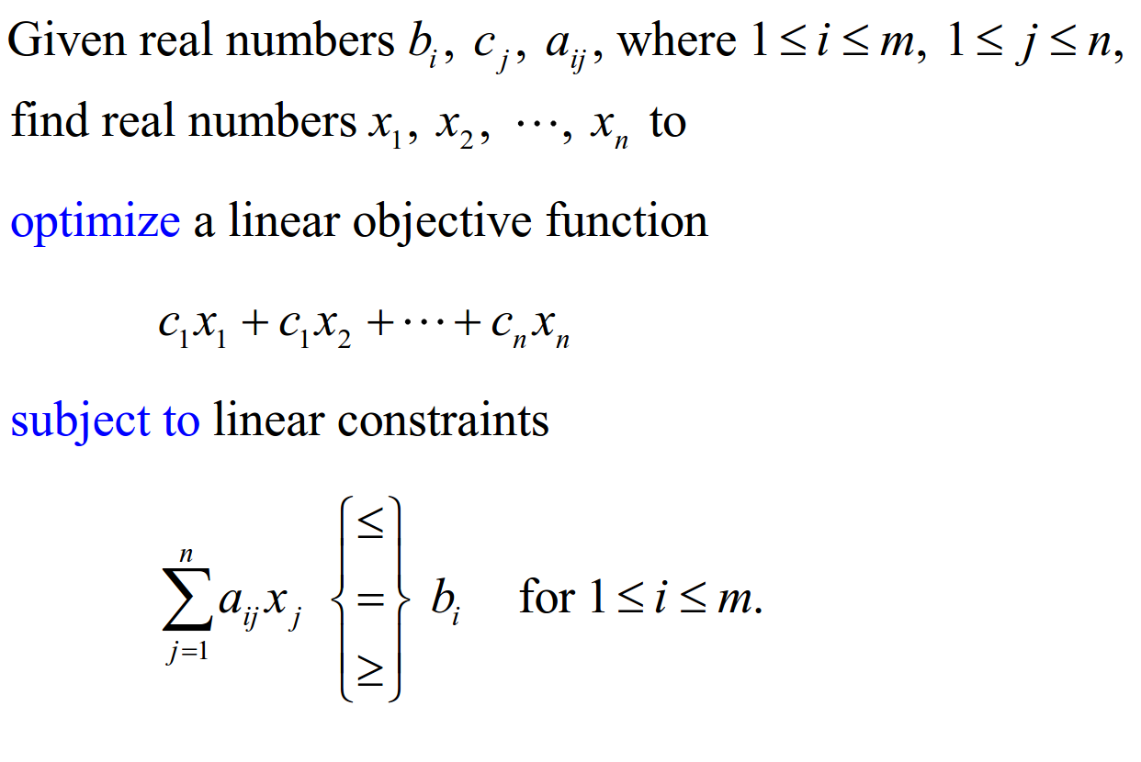
General Linear Programming Problem

Slide 4
Standard Maximum Form

Slide 6
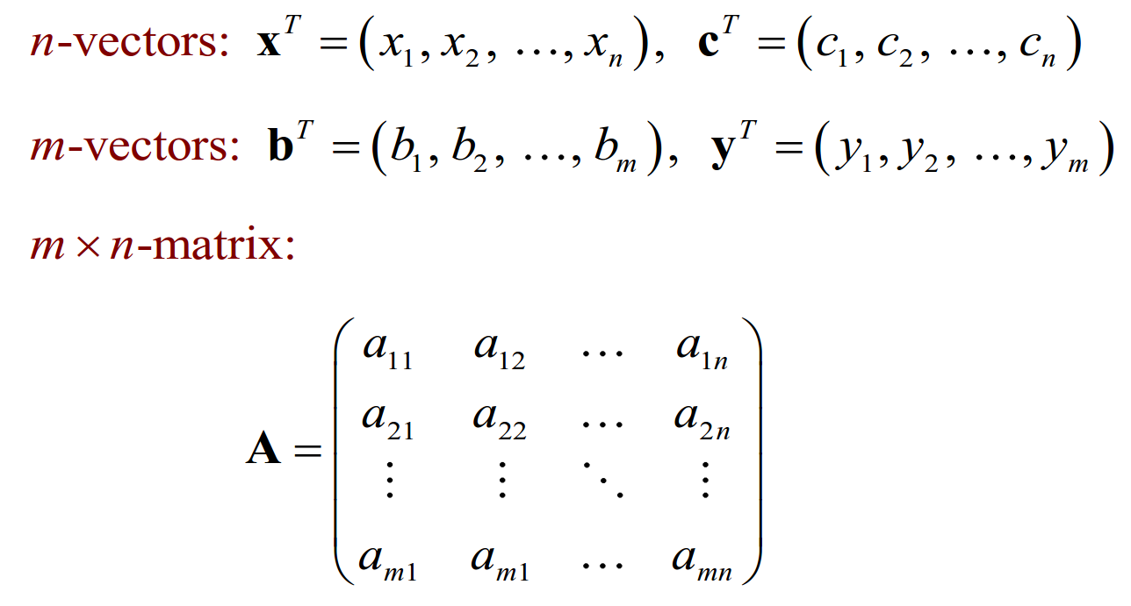

Slide 7
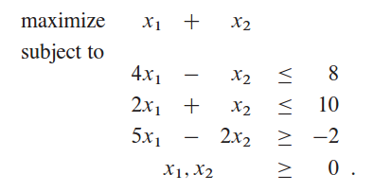
Linear Program Example
Let’s consider the following linear program with two variables:
Objective function
}
}
Inequality Constraints
Constrains
Non negitivity Constraints

Slide 8
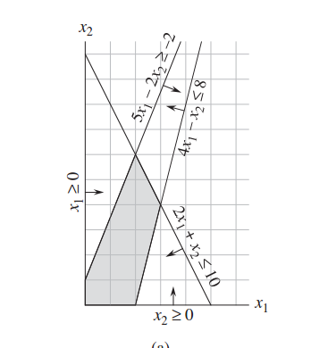
Linear Program Example
Feasible region

Slide 9
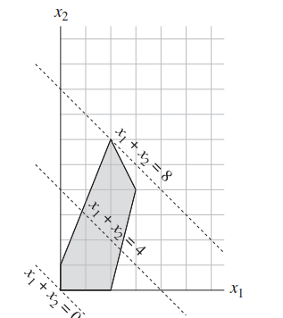
Linear Program Example
Optimal Feasible solution
Feasible solutions

Slide 10
Definitions
Feasible solution: a vector ( x1, x2, …. Xn) that satisfies all the constraints.
Feasible region: the set of all feasible solutions.
Optimal Solution: a feasible solution that optimizes the objective function.

Slide 11
Standard and Slack Forms
In standard form, all the constraints are inequalities.
In slack form, all constraints are equalities (except for those that require the variables to be nonnegative).

Slide 12
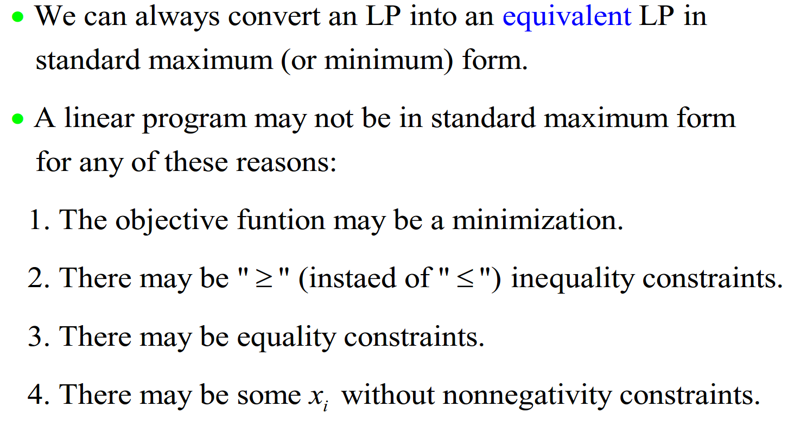
Converting to Standard Maximum Form

Slide 13
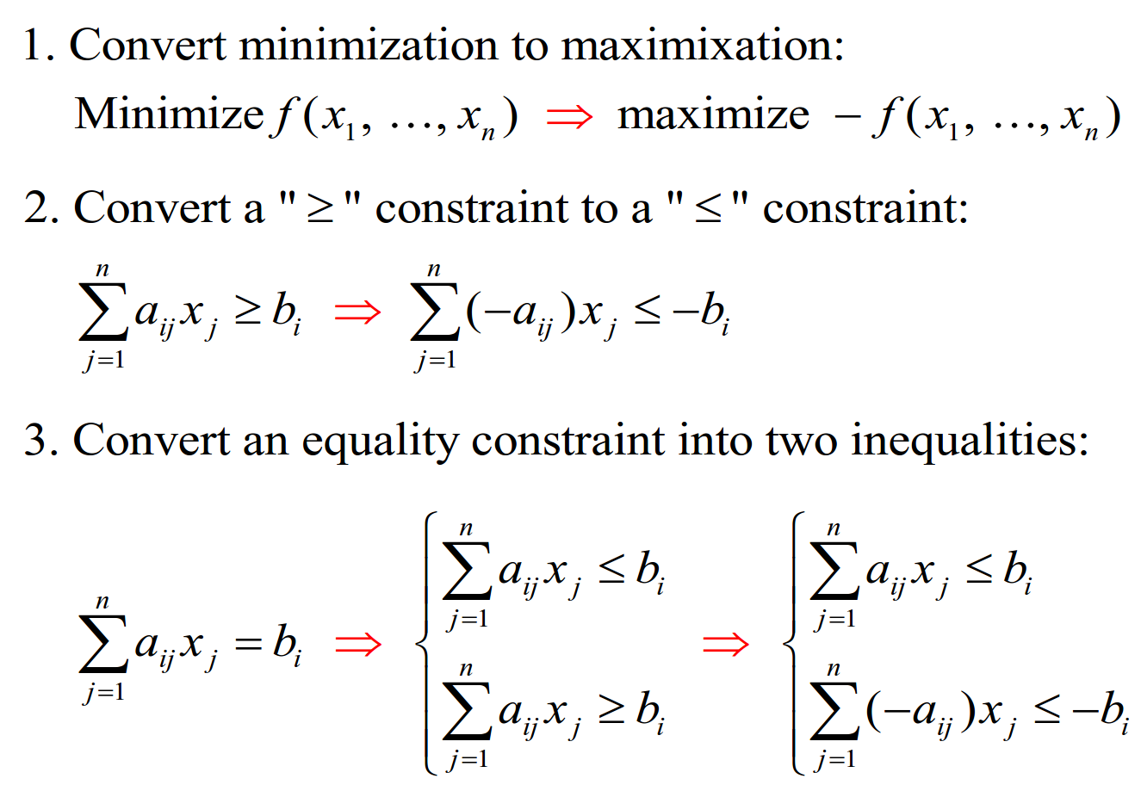

Slide 14
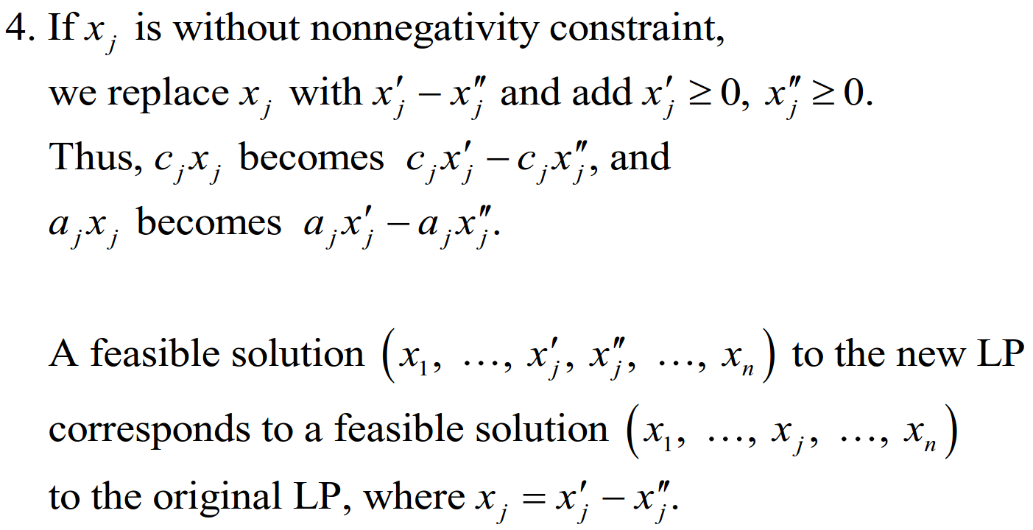

Slide 15
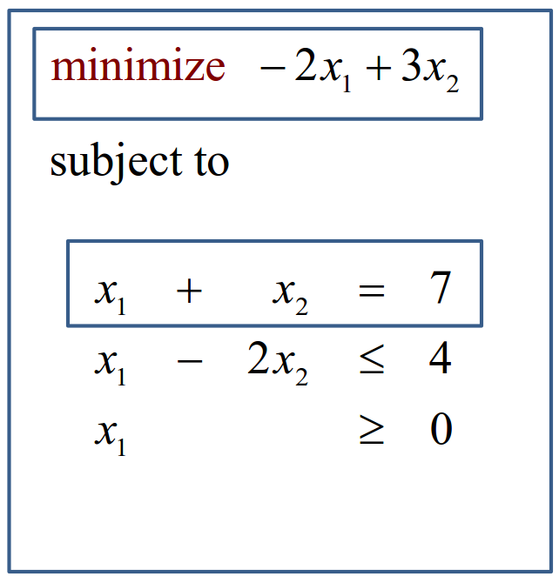
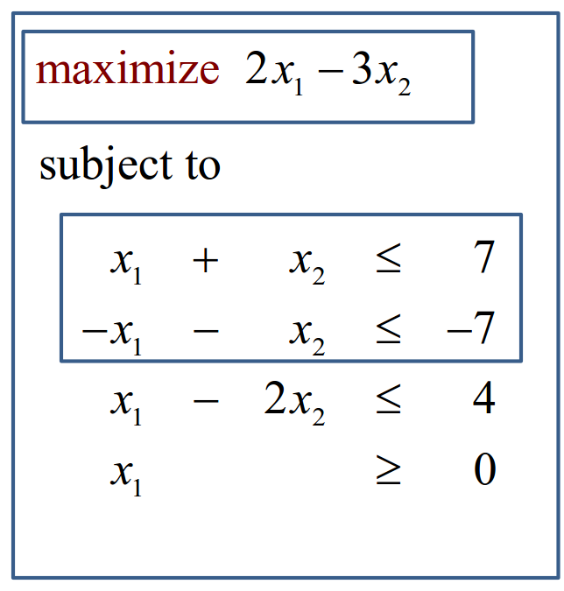
Example

Slide 16
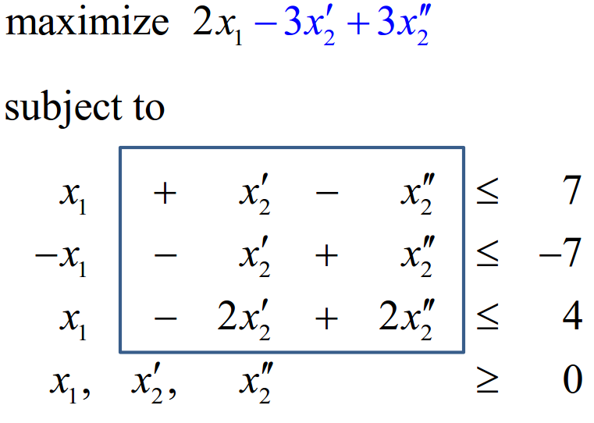
Example

Slide 17
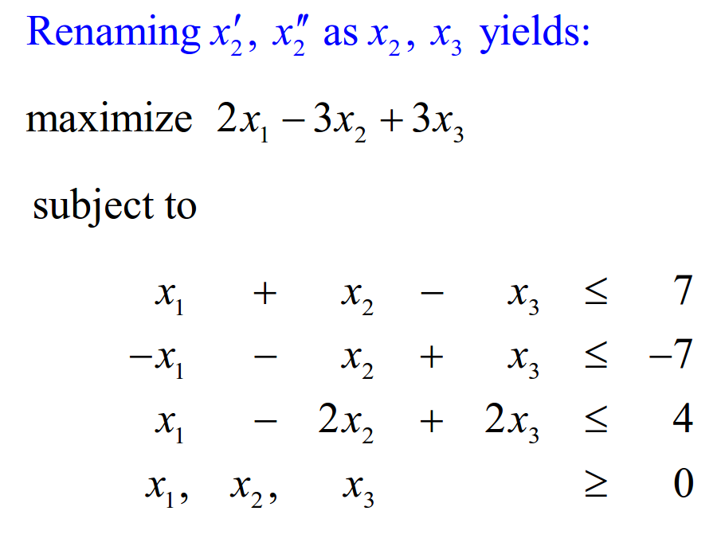
Example
Final Standard Form

Slide 18
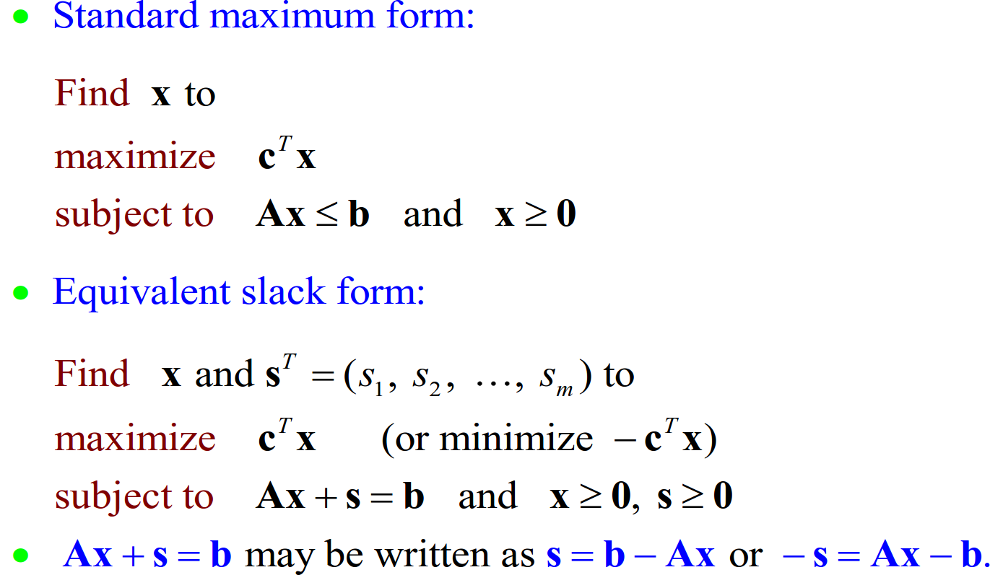
Convert Standard form to Slack form

Slide 19
The Simplex Method
When decision variables are more than 2, it is always advisable to use Simplex Method to avoid lengthy graphical procedure.
The simplex method is not used to examine all the feasible solutions.
It deals only with a small and unique set of feasible solutions, the set of vertex points of the convex feasible space that contains the optimal solution.

Slide 20
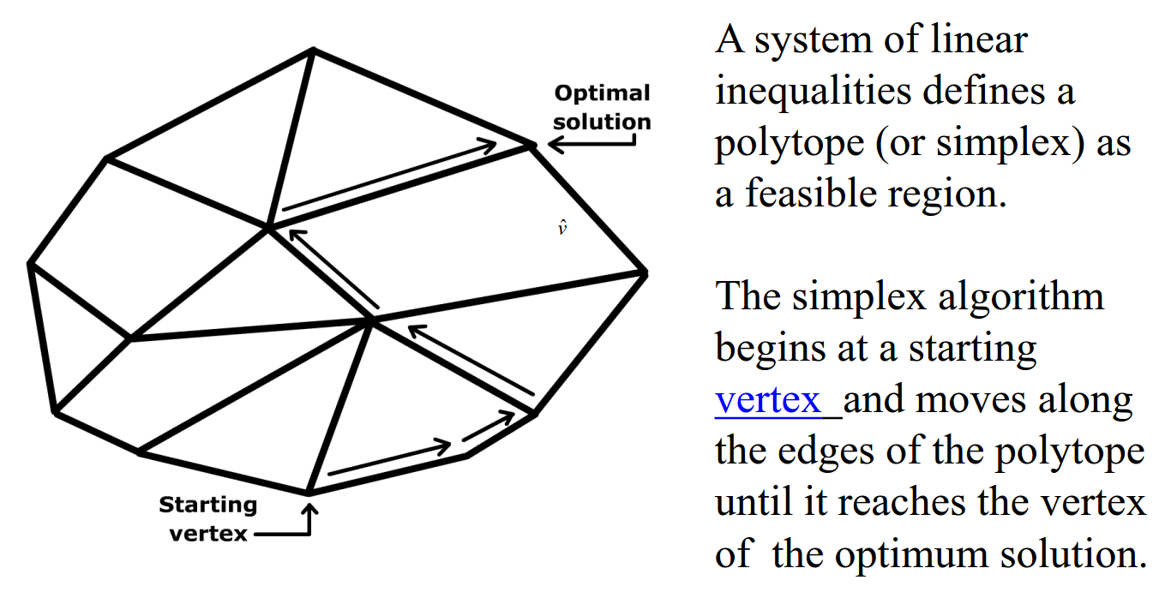
The Simplex Method

Slide 21
The Simplex Method Steps
Locate an extreme point of the feasible region.
Examine each boundary edge intersecting at this point to see whether movement along any edge increases the value of the objective function.
If the value of the objective function increases along any edge, move along this edge to the adjacent extreme point. If several edges indicate improvement, the edge providing the greatest rate of increase is selected.
Repeat steps 2 and 3 until movement along any edge no longer increases the value of the objective function.

Slide 22
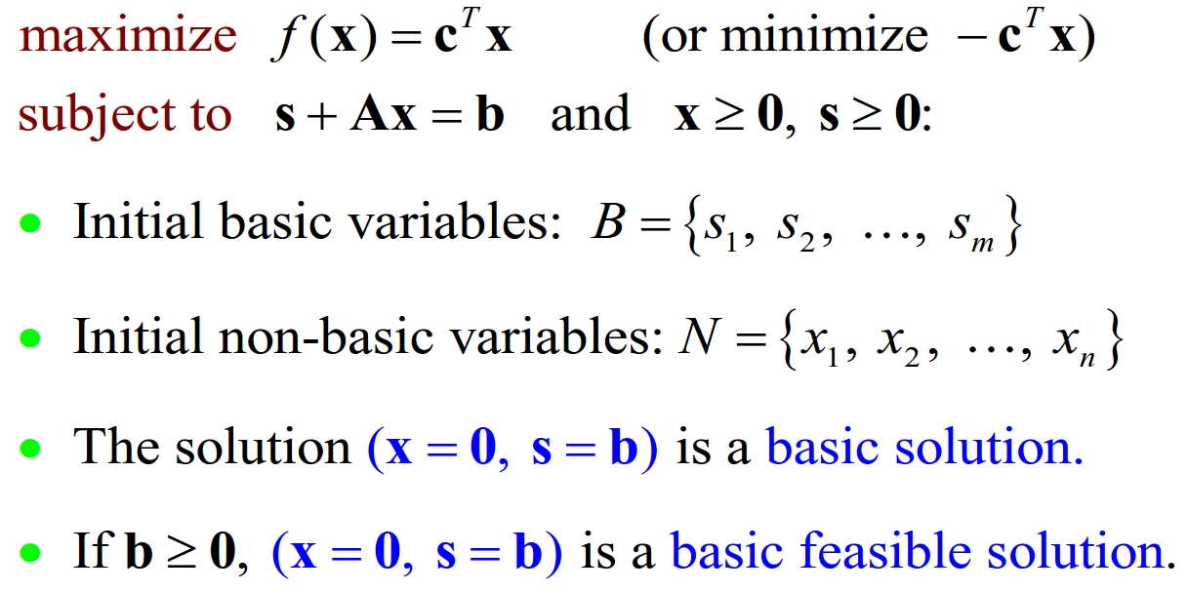
Basic and non-basic variables

Slide 23
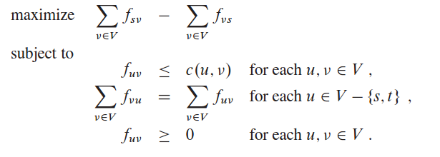
Formulating Problems as LP
Max Flows

Slide 24
Assignment
How to formulate the shortest path problem to LP ??

