Slide 1
Recovery

Slide 2
Review
Update Types (immediate, Deferred // shadow, in-place)
Flush Data Flags (Modified and Pin-Unpin)
Cache Flush Policy
Steal/No-Force (Undo/Redo) (immediate)
Steal/Force (Undo/No-redo)
No-Steal/No-Force (Redo/No-undo) (Deferred)
No-Steal/Force (No-undo/No-redo)
ARIES

Slide 3
Incremental logging with deferred updates implies that the recovery system must necessarily
a. store the old value of the updated item in the log.
b. store the new value of the updated item in the log.
c. store both the old and new value of the updated item in the log.
d. store only the Begin Transaction and Commit Transaction records in the log.

Slide 4
Incremental logging with deferred updates implies that the recovery system must necessarily
a. store the old value of the updated item in the log.
b. store the new value of the updated item in the log.
c. store both the old and new value of the updated item in the log.
d. store only the Begin Transaction and Commit Transaction records in the log.

Slide 5
The write-ahead logging (WAL) protocol simply means that
a. writing of a data item should be done ahead of any logging operation.
b. the log record for an operation should be written before the actual data is written.
c. all log records should be written before a new transaction begins execution.
d. the log never needs to be written to disk.

Slide 6
The write-ahead logging (WAL) protocol simply means that
a. writing of a data item should be done ahead of any logging operation.
b. the log record for an operation should be written before the actual data is written.
c. all log records should be written before a new transaction begins execution.
d. the log never needs to be written to disk.

Slide 7
In case of transaction failure under a deferred update incremental logging scheme, which of the following will be needed?
a. an undo operation
b. a redo operation
c. an undo and redo operation
d. none of the above

Slide 8
In case of transaction failure under a deferred update incremental logging scheme, which of the following will be needed?
a. an undo operation
b. a redo operation
c. an undo and redo operation
d. none of the above

Slide 9
For incremental logging with immediate updates, a log record for a transaction would contain
a. a transaction name, a data item name, and the old and new value of the item.
b. a transaction name, a data item name, and the old value of the item.
c. a transaction name, a data item name, and the new value of the item.
d. a transaction name and a data item name.

Slide 10
For incremental logging with immediate updates, a log record for a transaction would contain
a. a transaction name, a data item name, and the old and new value of the item.
b. a transaction name, a data item name, and the old value of the item.
c. a transaction name, a data item name, and the new value of the item.
d. a transaction name and a data item name.

Slide 11
For incremental logging with immediate updates, a log record for a transaction would contain
a. a transaction name, a data item name, and the old and new value of the item.
b. a transaction name, a data item name, and the old value of the item.
c. a transaction name, a data item name, and the new value of the item.
d. a transaction name and a data item name.

Slide 12
For correct behavior during recovery, undo and redo operations must be
a. commutative.
b. associative.
c. idempotent.
d. distributive.

Slide 13
For correct behavior during recovery, undo and redo operations must be
a. commutative.
b. associative.
c. idempotent.
d. distributive.

Slide 14
There is a possibility of a cascading rollback when
a. a transaction writes items that have been written only by a committed transaction.
b. a transaction writes an item that is previously written by an uncommitted transaction.
c. a transaction reads an item that is previously written by an uncommitted transaction.
d. both (b) and (c).

Slide 15
There is a possibility of a cascading rollback when
a. a transaction writes items that have been written only by a committed transaction.
b. a transaction writes an item that is previously written by an uncommitted transaction.
c. a transaction reads an item that is previously written by an uncommitted transaction.
d. both (b) and (c).

Slide 16
To cope with media (disk) failures, it is necessary
a. for the DBMS to only execute transactions in a single user environment.
b. to keep a redundant copy of the database.
c. to never abort a transaction.
d. all of the above.

Slide 17
To cope with media (disk) failures, it is necessary
a. for the DBMS to only execute transactions in a single user environment.
b. to keep a redundant copy of the database.
c. to never abort a transaction.
d. all of the above.

Slide 18
If the shadowing approach is used for flushing a data item back to disk, then
a. the item is written to disk only after the transaction commits.
b. the item is written to a different location on disk.
c. the item is written to disk before the transaction commits.
d. the item is written to the same disk location from which it was read.

Slide 19
If the shadowing approach is used for flushing a data item back to disk, then
a. the item is written to disk only after the transaction commits.
b. the item is written to a different location on disk.
c. the item is written to disk before the transaction commits.
d. the item is written to the same disk location from which it was read.

Slide 20
Roll-back

Slide 21
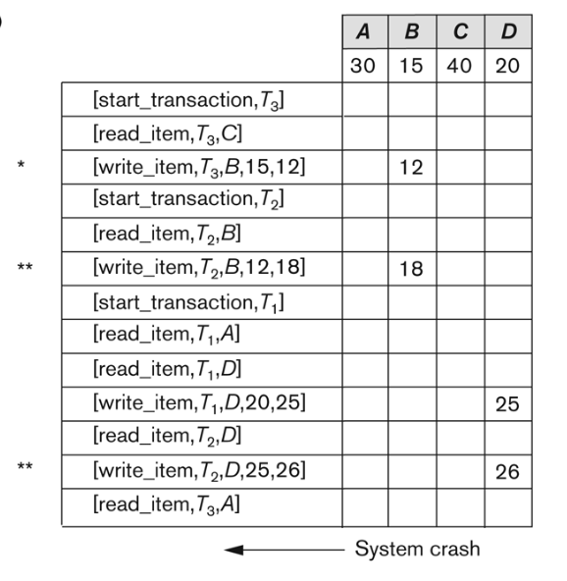
19.21 Rolling back
19.21 Suppose that the system crashes before the [read_item,T3,A] entry is written to the log will that make any difference in the recovery process? (assume auto-commit)

Slide 22
Rolling back
19.21 Suppose that the system crashes before the [read_item,T3,A] entry is written to the log will that make any difference in the recovery process? (assume auto-commit)
There will be no difference in the recovery process, because read_item operations are needed only for determining if cascading rollback of additional transactions is necessary.
Since T3 uncommitted it will roll back, T2 will cascaded roll-back as well
A=30 , B 15 , C=40 , D=25

Slide 23
19.22 Rolling back
19.22 Suppose that the system crashes before the [write_item,T2,D,25,26] entry is written to the log will that make any difference in the recovery process?
Since both transactions T2 and T3 are not yet committed, they have to be rolled back during the recovery process.
A=30 , B 15 , C=40 , D=25

Slide 24
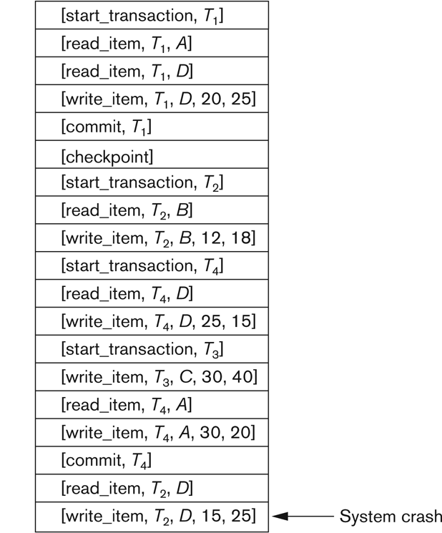
19.23 Roll-back(immediate)
Suppose that we use the immediate update protocol with checkpointing.
Describe the recovery process from the system crash.
Specify which transactions are rolled back,
which operations in the log are redone
and which (if any) are undone,
and whether any cascading rollback takes place.

Slide 25
19.23 Roll-back(immediate)
Suppose that we use the immediate update protocol with checkpointing.
Describe the recovery process from the system crash.

Slide 26
Checkpoints
During recovery we need to consider only the most recent transaction T_{i} that started before the checkpoint, and transactions that started after T_{i}.
Scan backwards from end of log to find the most recent <checkpoint> record
Continue scanning backwards till a record <T_{i} start> is found.
Need only consider the part of log following above start record. Earlier part of log can be ignored during recovery, and can be erased whenever desired.
For all transactions (starting from T_{i} or later) with no <T_{i} commit>, execute undo(T_{i}). (Done only in case of immediate modification.)
Scanning forward in the log, for all transactions starting from T_{i} or later with a <T_{i} commit>, execute redo(T_{i}).

Slide 27
19.23 Roll-back(immediate)
Suppose that we use the immediate update protocol with checkpointing.
Describe the recovery process from the system crash.
Specify which transactions are rolled back, (T2,T3)
which operations in the log are redone(T4)
and which (if any) are undone, (T2,T3)
and whether any cascading rollback takes place. (NO)
D=15

Slide 28
19.23 Roll-back(immediate)
Suppose that we use the immediate update protocol with checkpointing.
Describe the recovery process from the system crash.
Specify which transactions are rolled back, (T2,T3)
which operations in the log are redone(T4)
and which (if any) are undone, (T2,T3)
and whether any cascading rollback takes place. (NO)
D=15, C= 30

Slide 29
19.23 Roll-back(immediate)
Suppose that we use the immediate update protocol with checkpointing.
Describe the recovery process from the system crash.
Specify which transactions are rolled back, (T2,T3)
which operations in the log are redone(T4)
and which (if any) are undone, (T2,T3)
and whether any cascading rollback takes place. (NO)
D=15, C= 30,B=12

Slide 30
19.23 Roll-back(immediate)
Suppose that we use the immediate update protocol with checkpointing.
Describe the recovery process from the system crash.
Specify which transactions are rolled back, (T2,T3)
which operations in the log are redone(T4)
and which (if any) are undone, (T2,T3)
and whether any cascading rollback takes place. (NO)
D=15, C= 30,B=12 //start redo

Slide 31
19.23 Roll-back(immediate)
Suppose that we use the immediate update protocol with checkpointing.
Describe the recovery process from the system crash.
Specify which transactions are rolled back, (T2,T3)
which operations in the log are redone(T4)
and which (if any) are undone, (T2,T3)
and whether any cascading rollback takes place. (NO)
D=15, C= 30,B=1, A= 20

Slide 32
19.24 Roll-back(deferred)
Suppose that we use the deferred update protocol with checkpointing.
Describe the recovery process from the system crash.
Specify which transactions are rolled back, (T2,T3)
which operations in the log are redone(T4)
and which (if any) are undone, (NONE)
and whether any cascading rollback takes place. (NO)
A=20, B=12,C=30,D=15

Slide 33
19.24 Roll-back(deferred)
Suppose that we use the deferred update protocol with checkpointing.
Specify which transactions are rolled back, (T2,T3)
which operations in the log are redone(T4)
and which (if any) are undone, (NONE)
The transactions that are active and did not commit i.e., transactions T2 and T3 are canceled and must be resubmitted. Their operations do not have to be undone since they were never applied to the database.
and whether any cascading rollback takes place. (NO)
A=20, B=12,C=30,D=15

Slide 34
ARIES

Slide 35
19.25 How does checkpointing in ARIES differ from checkpointing as described in Section 19.1.4?
Answer: The main difference is that with ARIES, main memory buffers that have been modified are not necessary flushed to disk.
ARIES, however writes additional information to the LOG in the form of a Transaction Table and a Dirty Page Table when a checkpoint occurs.

Slide 36
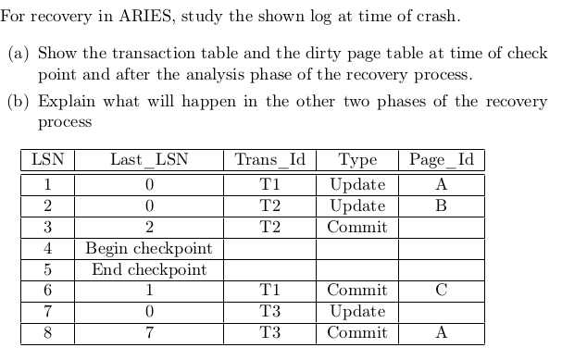
Aries

Slide 37
Aries at check point
Trans. ID | Last_LSN | Status
T1 | 1 | In progress
T2 | 3 | commit
Page_ID | First_LSN
A | 1 //start analysis from here
B | 2

Slide 38
Aries at check point
Trans. ID | Last_LSN | Status
T1 | 6 | commit
T2 | 3 | commit
T3 | 8 | commit
Page_ID | First_LSN
A | 1 //start analysis from here
B | 2
C | 6
Redo all, No undo

