Slide 1
WEB BUILDING USING Framework
Cairo University Faculty of Engineering Computer Engineering Department
CMPN 425-Fall 2018

Slide 2
The Used Technologies
Node.JS
Express.JS
MongoDB and Mongoose
PUG Template Engine (PUG = Jade)
Bootstrap
Package Managers and other Tools:
NPM (Node Package Manager)
Bower Package Manager
GIT Bash

Slide 3
Agenda
Introduction
Installation
Creating the Application and Using Express.JS
Routing
Templating (PUG)
Taking Form Data
Dealing with Database (MongoDB)
Integrating with Bootstrap

Slide 4
What is NodeJS ?
Node.js is a JavaScript runtime that allows you to run JavaScript on the server.
What can Node.js do?
Node.js can generate dynamic page content
Node.js can create, open, read, write, delete, and close files on the server
Node.js can collect form data
Node.js can add, delete, modify data in your database
Download and Install: https://nodejs.org/en/

Slide 5
What is Express.js?
Server-side web and mobile application framework
Language: written in JavaScript
Templating engines: some popular template engines that work with Express are Pug, Mustache, and EJS. The Express application generator uses Pug (Jade) as its default, but it also supports several others.
MVC pattern: Express supports the Model-View-Controller architecture, a really helpful way to build websites in a model-driven format.
Platform: Node.js
Operating system: It’s cross-platform, so it’s not limited to one OS.
Website: http://expressjs.com/
Notes:
You’re probably aware that JavaScript is the programming language most often used to add interactivity to the front end of a website, but its capabilities go far beyond that—entire sites can be built on JavaScript, extending it from the front to the back end, seamlessly.
Express.js and Node.js gave JavaScript newfound back-end functionality—allowing developers to build software with JavaScript on the server side for the first time. Together, they make it possible to build an entire site with JavaScript: You can develop server-side applications with Node.js and then publish those Node.js apps as websites with Express.
Because Node.js itself wasn’t intended to build websites, the Express framework is able to layer in built-in structure and functions needed to actually build a site. It’s a pretty lightweight framework that’s great for giving developers extra, built-in web application features and the Express API without overriding the already robust, feature-packed Node.js platform. In short, Express and Node are changing the way developers build websites.

Slide 6
What is MongoDB?
MongoDB is a schema-less NoSQL document database.
It means you can store JSON documents in it, and the structure of these documents can vary as it is not enforced like SQL databases.
This is one of the advantages of using NoSQL as it speeds up application development and reduces the complexity of deployments.
Instead of using tables and rows as in relational databases, the MongoDB architecture is made up of collections and documents.
Website: https://www.mongodb.com
Notes:
MongoDB is an open source database management system (DBMS) that uses a document-oriented database model.
It is one of numerous nonrelational database technologies which arose in the mid-2000s under the NoSQL banner for use in big data applications and other processing jobs involving data that doesn't fit well in a rigid relational model.
Reference: https://searchdatamanagement.techtarget.com/definition/MongoDB

Slide 7
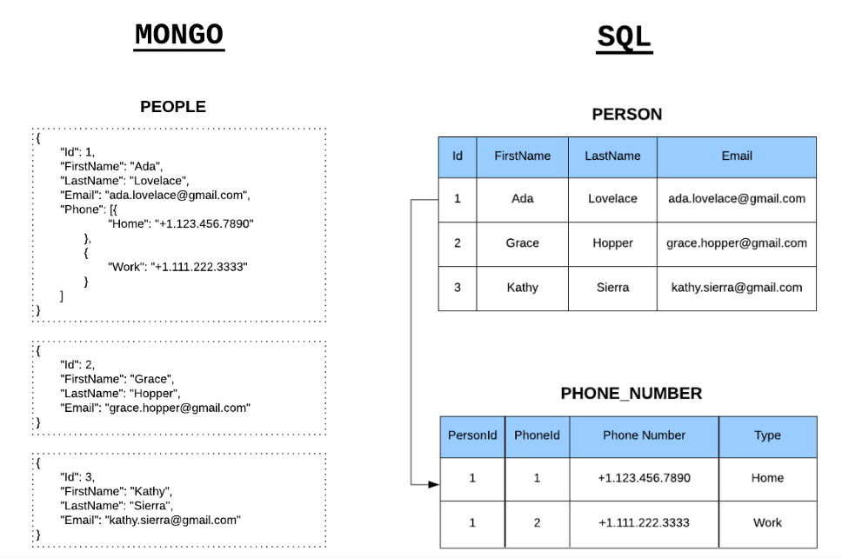
Notes:
Reference: https://medium.freecodecamp.org/introduction-to-mongoose-for-mongodb-d2a7aa593c57

Slide 8
MongoDB Terminology
Collections
‘Collections’ in Mongo are equivalent to tables in relational databases.
Documents
‘Documents’ are equivalent to records or rows of data in SQL.
Fields
‘Fields’ or attributes are similar to columns in a SQL table.
Schema
While Mongo is schema-less, SQL defines a schema via the table definition. A Mongoose ‘schema’ is a document data structure (or shape of the document) that is enforced via the application layer.
Models
‘Models’ are higher-order constructors that take a schema and create an instance of a document equivalent to records in a relational database.
Notes:
Reference: https://medium.freecodecamp.org/introduction-to-mongoose-for-mongodb-d2a7aa593c57

Slide 9
Mongoose
Mongoose is an Object Data Modeling (ODM) library for MongoDB and Node.js.
It manages relationships between data, provides schema validation, and is used to translate between objects in code and the representation of those objects in MongoDB.
Used by our application to interface with MongoDB
NoSQL is unstructured.
Mongoose enables us to give some structure to our collection in Application Level.
Website: https://mongoosejs.com/

Slide 10
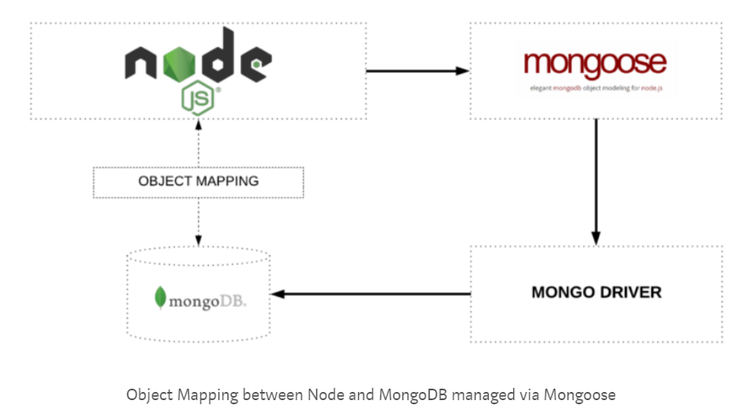
Mongoose

Slide 11
What is NPM?
npm is a package manager for the JavaScript programming language.
It is the default package manager for the JavaScript runtime environment Node.js.
When used as a dependency manager for a local project, npm can install, in one command, all the dependencies of a project through the package.json file.
It is downloaded automatically with Node.js

Slide 12
Download and Install
Download and Install the following:
Node.js Javascipt Runtime
MongoDB database program and start the service
Atom editor
Git Bash command line

Slide 13
Creating The package.json File
Create a folder in C:\ with your project name, say: nodekb
Open Git Bash in your application folder.
Then write this command in Git Bash:
$ npm init
It will ask you many questions about your application.
When it asks you about ‘entry point’, enter: app.js
Now, app.js will be the main js file for your node.js project.
This command will create a package.json file in your project folder.

Slide 14
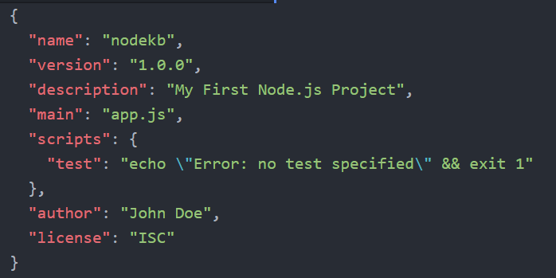
Creating The package.json File
The created package.json will all the app info (e.g. version, author, keywords, …etc).
In addition, it contains all the dependencies (modules) that are used in your application with their versions.

Slide 15
Creating The app.js File
Create app.js file inside your application folder.
Inside app.js file, write:
Then in Git Bash terminal, write:
$ node app.js
This command will run your app.js file with Node.js
You will see “Hello World” in the terminal (not in the console of the browser)

Slide 16
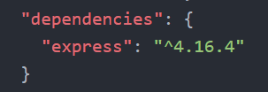
Installing Express.js
In Git Bash Terminal, type:
$ npm install --save express
This command will:
install express in your application
Create “node_modules” folder inside your application folder.
add ‘express’ in the “dependencies” of “package.json” file.

Slide 17
Including Express in app.js File
To be able to use express inside your app.js, write:
The second line makes an instance of express called, app
This instance will be used inside app.js to handle requests and send responses

Slide 18
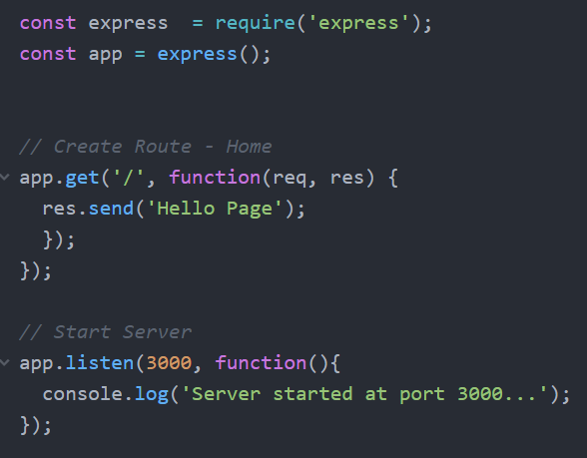
Starting Server and Making Home Route

Slide 19
Routing in Express.js
Routing refers to how an application responds to a client request to a particular URI (or path) and a specific HTTP request method (GET, POST, and so on).
You define routing using methods of the Express “app” object that correspond to HTTP methods.
For example, app.get( ) to handle GET requests and app.post( ) to handle POST requests.
These routing methods specify a callback function
The application “listens” for requests that match the specified route(s) and method(s), and when it detects a match, it calls the specified callback function.

Slide 20
Routing Examples
URL:
localhost:3000 Method: Get
URL:
localhost:3000/articles/add Method: Get
URL:
localhost:3000/articles/add Method: Post
URL:
localhost:3000/article/5 Method: Get

Slide 21
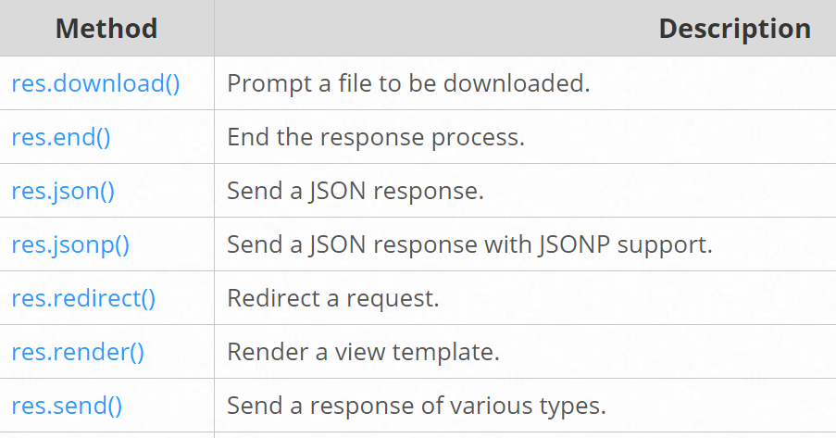
Response methods
The methods on the response object (res) in the following table can send a response to the client, and terminate the request-response cycle.

Slide 22
Template Engines
At runtime, the template engine replaces variables in a template file with actual values, and transforms the template into an HTML file sent to the client.
This approach makes it easier to design an HTML page.
Some popular template engines that work with Express are Pug, Mustache, and EJS.
The Express application generator uses PUG (Jade) as its default, but it also supports several others.

Slide 23
PUG Template Engine
To Install PUG,
$ npm install --save pug
Create a ‘views’ folder inside your application folder
The ‘views’ folder will contain all the template files (the .pug files) of your application (i.e. the Views of your application).
In app.js, write:

Slide 24
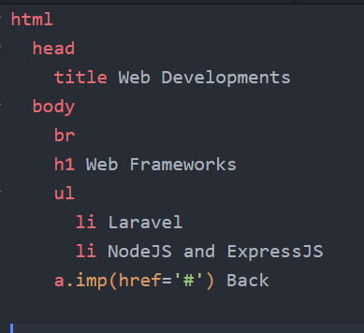
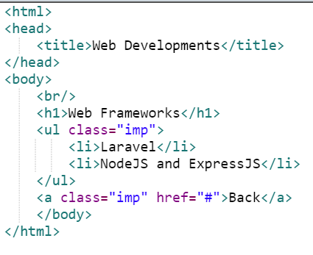
Examples of Pug: Example 1
views/index.pug file
Equivalent HTML
Note: PUG uses indentation to represent nested HTML elements
Notes:
There are online tools that converts from PUG to HTML and vice versa.

Slide 25
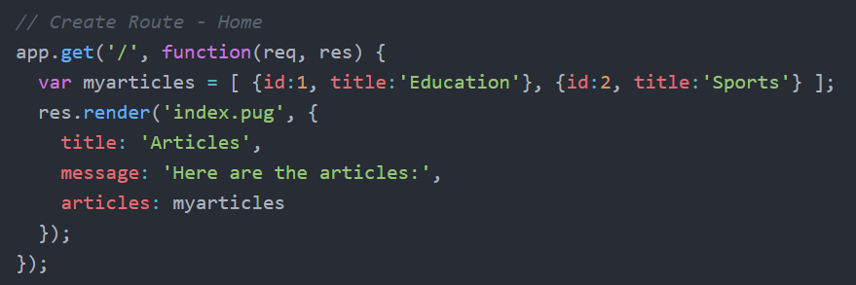
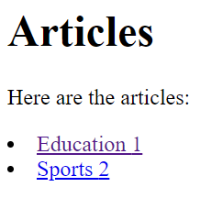
Examples of Pug: Example 2
The following function will be executed at: URL: localhost:3000 & Method: Get
In app.js
We want the resultant page to be →
Note that we used: res.render( ) instead of res.send( ) to render a template page (.pug file).

Slide 26
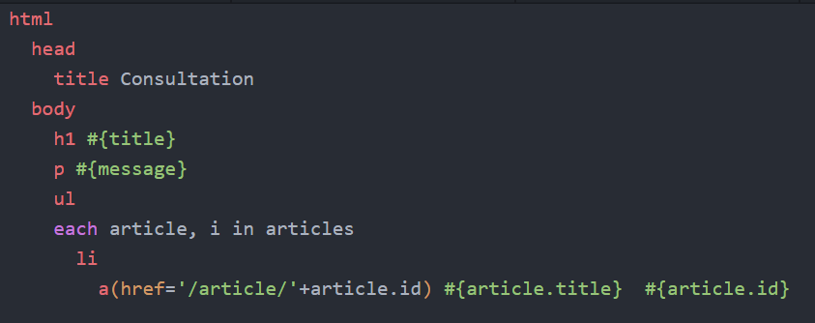
Examples of Pug: Example 2
views/index.pug file
Note that when an <a> link is clicked in the page, that will go to: localhost:3000/article/1 OR localhost:3000/article/2 depending on the id of the article that is clicked.
So, we should add a function: app.get(’/article/:id’, ……. ) in app.js to handle it.

Slide 27
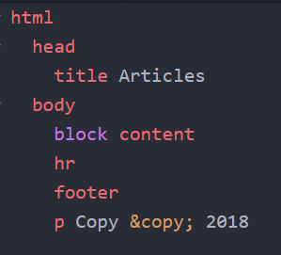
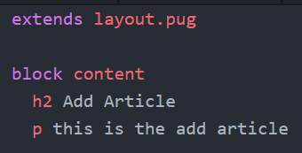
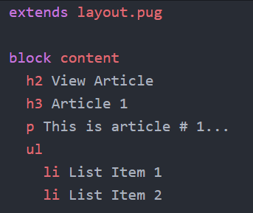
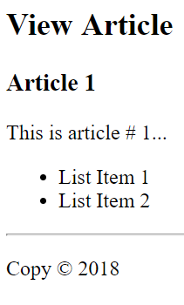
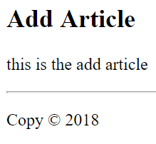
Inheritance of Pug Files
views/layout.pug
views/add_art.pug
views/view_art.pug

Slide 28
Inheritance of Pug Files
If you have a layout that are repeated in many pages, it is better to:
Add the common parts of the pages of your site in a file (e.g. layout.pug in our example)
Make the other pages extend that common layout file
In the previous example, the final content of add_art.pug will be:
The content of the layout.pug after replacing “block content” line with the lines written below “block content” of add_art.put file.

Slide 29
Taking Form Data
To be able to take form data using req.body.InputName, we need to install body-parser
Install body-parser using npm:
$ npm install --save body-parser
Then write this at the beginning of app.js file:

Slide 30
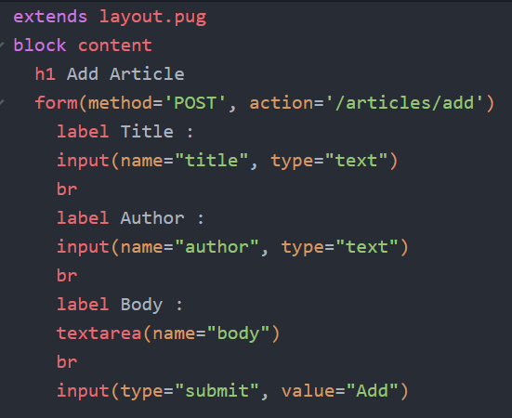
Taking Form Data
in app.js file
in article_form.pug

Slide 31
Taking Form Data
As you see in the previous slide, we make the form submit with “POST” method to “/article/add” URL
So, we need to define a route for this URL with this method to receive the form data in
Note that ‘title’, ‘author’ and ‘body’ are the “Name” attributes of input elements of the form.

Slide 32
Create Database in MongoDB
After installing MongoDB from its website and starting the service (Search about it!), perform the following:
Open the normal command line in the bin folder of mongodb installed folder, then write the following commands:
$ mongo
Create and use database called: nodekb $ use nodekb
Create a collection (table) called: articles $ db.createCollection(‘articles’)
Insert a document (row) in the articles collection $ db.articles.insert( { title:’article 1’, author:’Omar’, body:’hello’ } )
$ db.articles.insert( { title:’article 2’, author:’Adel’, body:’hi’ } )
Note that MongoDB inserts a unique id (called: _id ) for each document

Slide 33
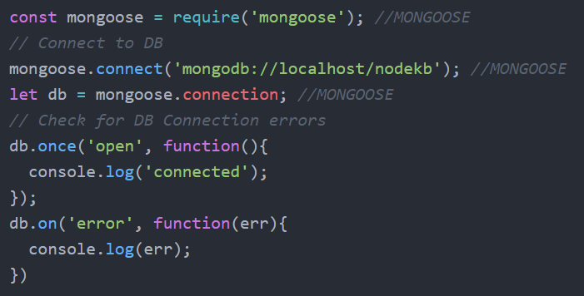
Installing and Using Mongoose to Connect to the Database
Install Mongoose in your application folder using npm:
$ npm install --save mongoose
In app.js add the following:

Slide 34
Creating the Model
Create a folder called “models” inside your application folder
The “models” folder will contain your models files (.js files, each one is corresponding to a db collection - table)
Create file called: article.js inside the “models” folder
Remember: NoSQL is unstructured. Mongoose enables us to give some structure to our collection in Application Level. This is what we will make in article.js file.

Slide 35
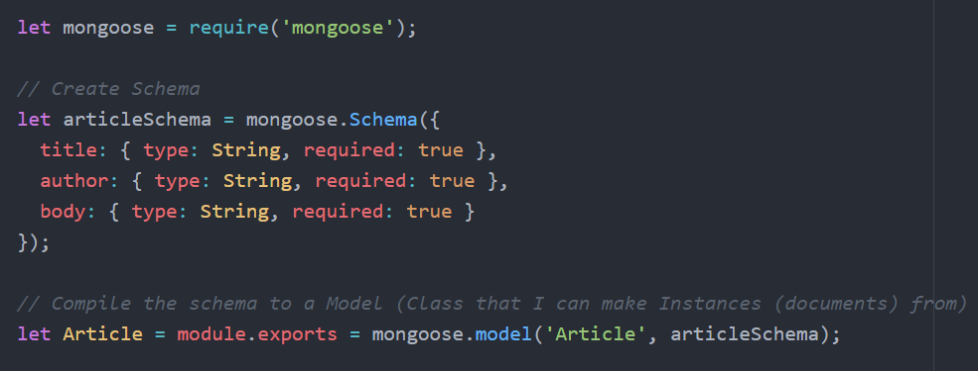
The model file: article.js
In the model file: article.js
Now we have a model called: ‘Article’ that we can make instances from

Slide 36
Retrieve All Documents of a DB Collection
In app.js file, write:
Now, you can use model “Article” in your app.js
To retrieve all the documents of a collection, function find( ) is used
The empty { } inside the find function is to select ALL the documents

Slide 37
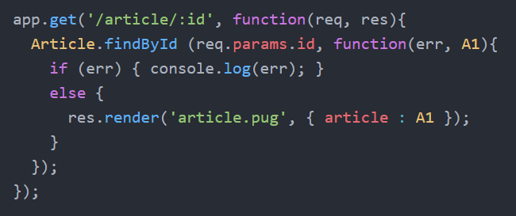
Retrieve the data of a document given its id
To retrieve the data of a document given its id, function findById( ) is used
req.params.id is used to get the id send in the URL.

Slide 38
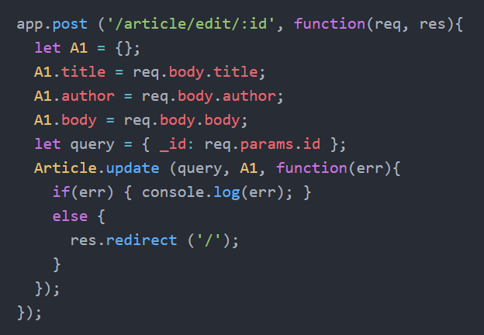
Update the data of a document
Assume we have a form that reads the data of an article and submit it tothe following URL using a POST

Slide 39
Update the data of a document
To update the data of a document, use function update ( ) which takes :
The query that selects which document(s) to be updated
let query = { _id: req.params.id }; Returns the document that _id field of it equals the id passed in the URL.
An object that contains the updated values
A callback function that has an error object as a parameter on which we check if no error occurs to make some action accordingly. In the previous example, if no errors occurred, the response is made by redirecting to the home page:
res.redirect ('/');

Slide 40
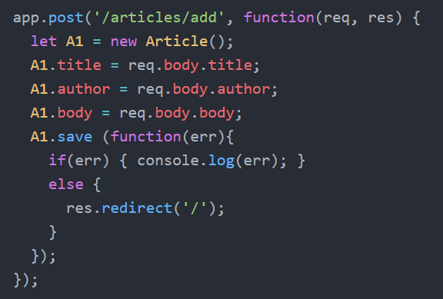
Add a Document in a DB Collection
To insert a document in the db collection, make an instance of your Model, fill it with data, then use function save ( ) to save it to db.
A1 is an Instance of model Article
Here we fill A1

Slide 41
How to integrate with bootstrap?
Create folder called “public” inside your application folder
Make it a static folder (that contains assets like images, css files, js files, …etc.):
Bower is used to install front-end frameworks (like bootstrap).
Install bower: $ npm install -g bower
Create file called: .bowerrc inside your application folder and write inside it:
This directory is where the components installed by bower are stored

Slide 42
How to integrate with bootstrap?
To install Bootstrap using Bower, write the following command:
$ bower install bootstrap
Bower is supposed to install also the dependencies of bootstrap (i.e. jQuery) but if not, use the same command written above to install jQuery ( by replacing bootstrap with jquery ).
In addition, create folder “css” inside the “public” folder
Inside the “css” folder, add “style.css” file. This file should contain the custom css style that you want for your application.
In the same way create, “js/main.js” inside the “public” folder. The “main.js” file should contain the client-side javascript code.

Slide 43
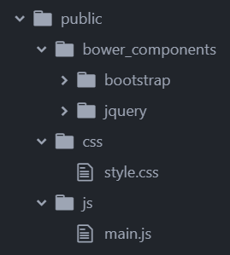
How to integrate with bootstrap?
Your hierarchy of the “public” folder we created will be something like the following:

Slide 44
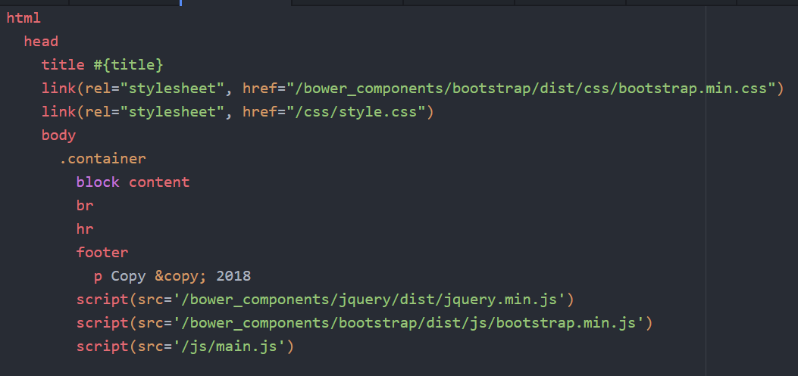
How to integrate with bootstrap?
Add the link and script elements normally in PUG.
in layout.pug file
This means a <div> with class ‘container’ of bootstrap

Slide 45
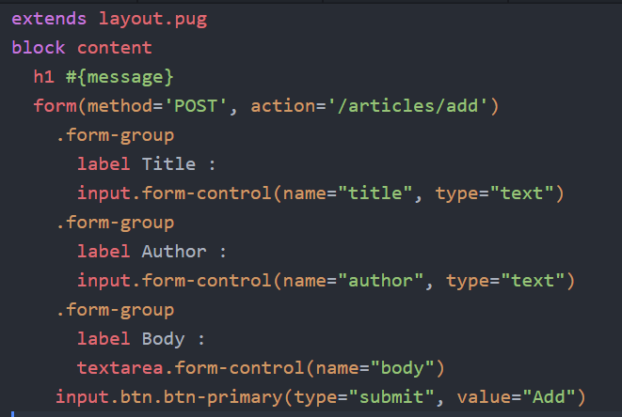
How to integrate with bootstrap?
in add_article.pug

Slide 46
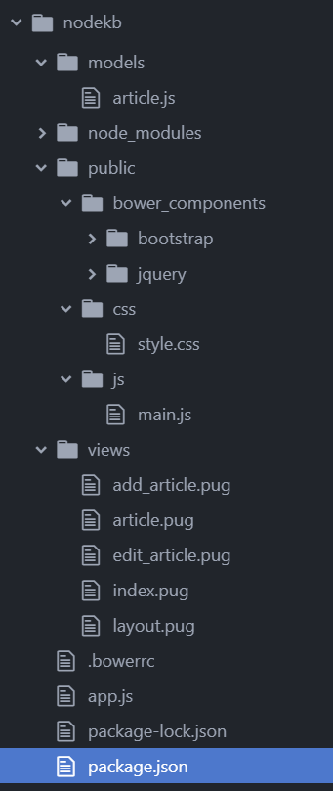
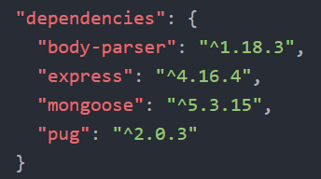
Final Folder Hierarchy
These could be the final dependencies found in the package.json file:
The final folder hierarchy of your application maybe something like the following:

Slide 47
References
One of the best Playlists: https://www.youtube.com/playlist?list=PLillGF-RfqbYRpji8t4SxUkMxfowG4Kqp
Crash Course on ExpressJs and NodeJS (all in 1 hour): https://youtu.be/gnsO8-xJ8rs
Another one (in 1 hour): https://youtu.be/pKd0Rpw7O48
This link contains the main guide of express js: http://expressjs.com/ Read the "Getting Started" and "Guide" links.
This Playlist contains one-hour crash course of many frameworks, it helps you a lot if you want to know the basics of many frameworks: https://www.youtube.com/playlist?list=PLillGF-RfqbYeckUaD1z6nviTp31GLTH8
Notes:
https://www.upwork.com/hiring/development/express-js-a-server-side-javascript-framework/
https://medium.freecodecamp.org/introduction-to-mongoose-for-mongodb-d2a7aa593c57

Slide 48
Things to Search for
Nodemon and what is the importance of it
Atom-pug and what is the importance of it
What is RESTful API?
What is CRUD functionality?
What is the MEAN stack?
We didn’t include how to delete from db. Search for a method using AJAX and jQuery.
Hint: if you have problems in starting the service of MongoDB, try downloading an earlier version of MongoDB.

