Slide 1
CMPN 425 Fall 2018 Styling your pages using CSS & Bootstrap
Cairo University
Faculty of Engineering
Computer Engineering Department

Slide 2
Agenda
Cascading Style Sheets (CSS)
Bootstrap Framework
Bootstrap CSS & Components

Slide 3
Cascading Style Sheets
Styles define how to display HTML elements
Styles were added to HTML 4.0 to solve the problem where fonts , color… information were added to every single page, became a long and expensive process.
External style sheets enable you to change the appearance and layout of all the pages in a Web site, just by editing one single file!
External Style Sheets are stored in CSS files.

Slide 4
Cascading Style Sheets
Styling can be added to HTML elements in 3 ways:
Inline - using a style attribute in HTML elements
Internal - using a <style> element in the HTML <head> section
External - using one or more external CSS files

Slide 5
CSS Syntax
The element/selector is an HTML element name.
The property is a CSS property.
The value is a CSS value.
Multiple styles are separated with semicolon.

Slide 6
Inline Styling (Inline CSS)
Inline styling is useful for applying a unique style to a single HTML element.
Inline styling uses the style attribute.
This inline styling changes the text color of a single heading:

Slide 7
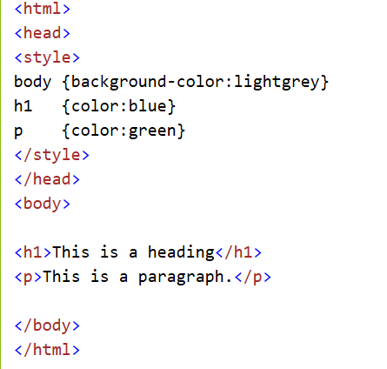
Internal Styling (Internal CSS)
An internal style sheet can be used to define a common style for all HTML elements on a page.
Internal styling is defined in the <head> section of an HTML page, using a <style> element:

Slide 8
External Styling (External CSS)
External style sheet are ideal when the style is applied to many pages.
With external style sheets, you can change the look of an entire web site by changing one file.
External styles are defined in an external CSS file, and then linked to in the <head> section of an HTML page

Slide 9
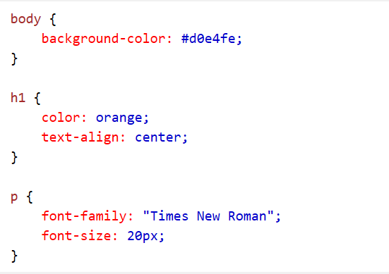
External Styling (External CSS)
Styles.css

Slide 10
CSS Comments
/*This is a comment*/

Slide 11
The id Attribute
To define a special style for one special element, first add an id attribute to the element:
then define a different style for the (identified) element:

Slide 12
The id Attribute-Example

Slide 13
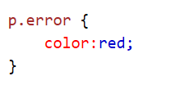
The class Attribute
To define a style for a special type (class) of elements, add a class attribute to the element:
Now you can define a different style for all elements with the specified class:

Slide 14
The class Attribute-Example
<html>
<head>
<style type="text/css">
. center
{
text-align:center;
}
</style>
</head>
<body>
<h1 class="center">Center-aligned heading</h1>
<p class="center">Center-aligned paragraph.</p>
</body>
</html>

Slide 15
The class Attribute
You can also specify that only specific HTML elements should be affected by a class.
In the next example, ONLY p elements with class="center" will be center-aligned:
<html>
<head>
<style type="text/css">
p. center
{
text-align:center;
}
</style>
</head>
<body>
<h1 class="center">The heading will not be affected</h1>
<p class="center">Center-aligned paragraph.</p>
</body>
</html>

Slide 16
CSS Multiple style sheets
External style sheet has these properties for the h3 selector:
h3 { color:red; text-align:left; font-size:8pt; }
Internal style sheet has these properties for the h3 selector:
h3 { text-align:right; font-size:20pt; }
color:red; text-align:right; font-size:20pt;

Slide 17
Multiple Styles Will Cascade into One
What style will be used when there is more than one style specified for an HTML element?
Generally speaking we can say that all the styles will "cascade" into a new "virtual" style sheet by the following rules, where number four has the highest priority:
Browser default
External style sheet
Internal style sheet (in the head section)
Inline style (inside an HTML element)

Slide 18
CSS BOX Model
Explanation of the different parts:
Content - The content of the box, where text and images appear
Padding - Clears an area around the content. The padding is transparent
Border - A border that goes around the padding and content
Margin - Clears an area outside the border. The margin is transparent

Slide 19
CSS BOX Model

Slide 20
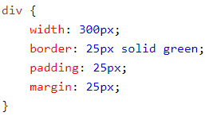
CSS BOX Model

Slide 21
CSS – inline - block

Slide 22
CSS – inline - block

Slide 23
Agenda
Cascading Style Sheets (CSS)
Bootstrap Framework
Bootstrap CSS & Components

Slide 24
Bootstrap Framework
Bootstrap is a free front-end framework (HTML and CSS) for faster and easier web development
Bootstrap is famous for being developed with components that have the ability to follow the property of responsive designs
Responsive Design is about using CSS and HTML to resize, hide, shrink, enlarge, or move the content to make it look good on any screen
Responsive Design allow your page works for computer, tablets and mobile phones.
In other words, bootstrap is a collection of CSS classes and JavaScript functions the you get ready to use and will not worry about write code

Slide 25
What is Responsive Design ?
The design that works properly on any resolution .
It majorly concerns with standard devices resolutions.
User friendly approach.

Slide 26
What is the most important thing to understand in Bootstrap?
Grid System
Bootstrap includes a responsive, mobile first fluid grid system that appropriately scales up to 12 columns as the device or viewport size increases. It includes predefined classes for easy layout options.
Grid systems are used for creating page layouts through a series of rows and columns that house your content.
Grid classes apply to devices with screen widths greater than or equal to the breakpoint sizes, and override grid classes targeted at smaller devices. Therefore, applying any - md- class to an element will not only affect its styling on medium devices but also on large devices if a -lg- class is not present.

Slide 27
Bootstrap Grid
This is the best part about the new grid system. You could realistically have your site show a different grid on 4 different browser sizes. Below is the breakdown of the different sizes.
.col-xs-$ | Extra Small | Phones Less than 768px
.col-sm-$ | Small Devices | Tablets 768px and Up
.col-md-$ | Medium Devices | Desktops 992px and Up
.col-lg-$ | Large Devices | Large Desktops 1200px and Up
The official Bootstrap docs offer a much more comprehensive understanding of how the grid works. Take a look at those to get a more solid overview of column sizes, gutter sizes, maximum column sizes, and the max-width of your overall site based on browser size.

Slide 28
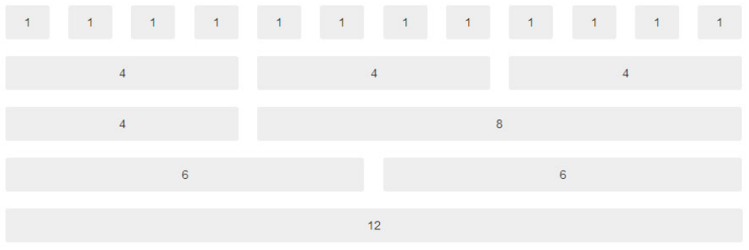
Bootstrap Grid Example (Cols & Rows)
Bootstrap's grid system allows up to 12 columns across the page
You can divide the container in rows and each row in columns with space multiple of the 12

Slide 29
Agenda
Cascading Style Sheets (CSS)
Bootstrap Framework
Bootstrap CSS & Components

Slide 30
Using Bootstrap
You will need to include three files:
bootstrap.min.css
jquery.min.js
bootstrap.min.js
You must download it and include in you page

Slide 31
Starter Template

Slide 32
Bootstrap Grid Example Code

Slide 33
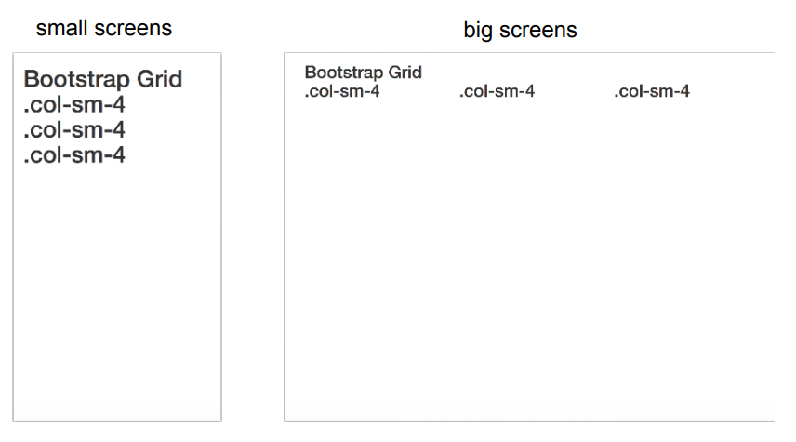
Bootstrap Grid Example Code

Slide 34
Bootstrap Tables

Slide 35
Bootstrap Tables

Slide 36
Bootstrap Images

Slide 37
Bootstrap Images

Slide 38
Bootstrap Alerts

Slide 39
Bootstrap Alerts

Slide 40
Bootstrap Buttons

Slide 41
Bootstrap Glyphicons

Slide 42
Bootstrap Glyphicons

Slide 43
Bootstrap Forms

Slide 44
Bootstrap Forms

Slide 45
Wrap UP
We talked about
CSS
Bootstrap Framework
Understanding the Grid system of bootstrap
Bootstrap Components

