Slide 2
23.24 Consider the relational database schema Write SQL statements to grant these privileges. Use views were appropriate:
(a) Account A can retrieve or modify any relation except DEPENDENT and can grant any of these privileges to other users.

Slide 3
23.24 Consider the relational database schema Write SQL statements to grant these privileges. Use views were appropriate:
(a) Account A can retrieve or modify any relation except DEPENDENT and can grant any of these privileges to other users.
GRANT SELECT, UPDATE
ON EMPLOYEE, DEPARTMENT,
DEPT_LOCATIONS, PROJECT,
WORKS_ON
TO USER_A
WITH GRANT OPTION;

Slide 4
23.24 Consider the relational database schema Write SQL statements to grant these privileges. Use views were appropriate:
(b) Account B can retrieve all the attributes of EMPLOYEE and DEPARTMENT
except for SALARY, MGRSSN, and MGRSTARTDATE.

Slide 5
23.24 Consider the relational database schema Write SQL statements to grant these privileges. Use views were appropriate:
(b) Account B can retrieve all the attributes of EMPLOYEE and DEPARTMENT
except for SALARY, MGRSSN, and MGRSTARTDATE.
CREATE VIEW EMPS AS
SELECT FNAME, MINIT, LNAME, SSN,
BDATE, ADDRESS, SEX,SUPERSSN,
DNO
FROM EMPLOYEE;
GRANT SELECT ON EMPS
TO USER_B;
CREATE VIEW DEPTS AS
SELECT DNAME, DNUMBER FROM
DEPARTMENT;
GRANT SELECT ON DEPTS
TO USER_B;

Slide 6
23.24 Consider the relational database schema Write SQL statements to grant these privileges. Use views were appropriate:
(c) Account C can retrieve or modify WORKS_ON but can only retrieve the
FNAME, MINIT, LNAME, SSN attributes of EMPLOYEE and the PNAME,
PNUMBER attributes of PROJECT.

Slide 7
23.24 Consider the relational database schema Write SQL statements to grant these privileges. Use views were appropriate:
(c) Account C can retrieve or modify WORKS_ON but can only retrieve the
FNAME, MINIT, LNAME, SSN attributes of EMPLOYEE and the PNAME,
PNUMBER attributes of PROJECT.
GRANT SELECT, UPDATE ON WORKS_ON
TO USER_C;
CREATE VIEW EMP1 AS
SELECT FNAME, MINIT, LNAME, SSN
FROM EMPLOYEE;
GRANT SELECT ON EMP1
TO USER_C;

Slide 8
23.24 Consider the relational database schema Write SQL statements to grant these privileges. Use views were appropriate:
(c) Account C can retrieve or modify WORKS_ON but can only retrieve the
FNAME, MINIT, LNAME, SSN attributes of EMPLOYEE and the PNAME,
PNUMBER attributes of PROJECT.
CREATE VIEW PROJ1 AS
SELECT PNAME, PNUMBER
FROM PROJECT;
GRANT SELECT ON PROJ1
TO USER_C:

Slide 9
23.24 Consider the relational database schema Write SQL statements to grant these privileges. Use views were appropriate:
(d) Account D can retrieve any attribute of EMPLOYEE or DEPENDENT and can
modify DEPENDENT.

Slide 10
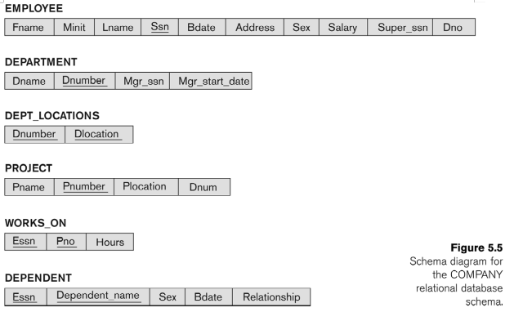
23.24 Consider the relational database schema Write SQL statements to grant these privileges. Use views were appropriate:
(d) Account D can retrieve any attribute of EMPLOYEE or DEPENDENT and can
modify DEPENDENT.
GRANT SELECT ON EMPLOYEE,
DEPENDENT TO USER_D;
GRANT UPDATE ON
DEPENDENT TO USER_D;

Slide 11
23.24 Consider the relational database schema Write SQL statements to grant these privileges. Use views were appropriate:
(e) Account E can retrieve any attribute of EMPLOYEE but only for EMPLOYEE
tuples that have DNO = 3.

Slide 12
23.24 Consider the relational database schema Write SQL statements to grant these privileges. Use views were appropriate:
(e) Account E can retrieve any attribute of EMPLOYEE but only for EMPLOYEE
tuples that have DNO = 3.
CREATE VIEW DNO3_EMPLOYEES
AS SELECT * FROM EMPLOYEE
WHERE DNO=3;
GRANT SELECT ON
DNO3_EMPLOYEES TO USER_E;

Slide 14
How would it appear to a user with classification U?

Slide 15
How would it appear to a user with classification U?
Name | Salary | JobPerformance | TC
Smith U | NULL | NULL | NULL

Slide 16
Suppose a classification U user tries to update the salary of "Smith" to $50,000; what would be the result of this action?
Name | Salary | JobPerformance | TC
Smith U | 40000 U | Fair S | S
Smith U | 40000 U | Excellent C | C
Smith U | 50000 U | NULL | U
Brown C | 80000 S | Good C | S

Slide 18
Incremental logging with deferred updates implies that the recovery system must necessarily
a. store the old value of the updated item in the log.
b. store the new value of the updated item in the log.
c. store both the old and new value of the updated item in the log.
d. store only the Begin Transaction and Commit Transaction records in the log.

Slide 19
Incremental logging with deferred updates implies that the recovery system must necessarily
a. store the old value of the updated item in the log.
b. store the new value of the updated item in the log.
c. store both the old and new value of the updated item in the log.
d. store only the Begin Transaction and Commit Transaction records in the log.

Slide 20
The write-ahead logging (WAL) protocol simply means that
a. writing of a data item should be done ahead of any logging operation.
b. the log record for an operation should be written before the actual data is written.
c. all log records should be written before a new transaction begins execution.
d. the log never needs to be written to disk.

Slide 21
The write-ahead logging (WAL) protocol simply means that
a. writing of a data item should be done ahead of any logging operation.
b. the log record for an operation should be written before the actual data is written.
c. all log records should be written before a new transaction begins execution.
d. the log never needs to be written to disk.

Slide 22
In case of transaction failure under a deferred update incremental logging scheme, which of the following will be needed?
a. an undo operation
b. a redo operation
c. an undo and redo operation
d. none of the above

Slide 23
In case of transaction failure under a deferred update incremental logging scheme, which of the following will be needed?
a. an undo operation
b. a redo operation
c. an undo and redo operation
d. none of the above

Slide 24
For incremental logging with immediate updates, a log record for a transaction would contain
a. a transaction name, a data item name, and the old and new value of the item.
b. a transaction name, a data item name, and the old value of the item.
c. a transaction name, a data item name, and the new value of the item.
d. a transaction name and a data item name.

Slide 25
For incremental logging with immediate updates, a log record for a transaction would contain
a. a transaction name, a data item name, and the old and new value of the item.
b. a transaction name, a data item name, and the old value of the item.
c. a transaction name, a data item name, and the new value of the item.
d. a transaction name and a data item name.

Slide 26
For incremental logging with immediate updates, a log record for a transaction would contain
a. a transaction name, a data item name, and the old and new value of the item.
b. a transaction name, a data item name, and the old value of the item.
c. a transaction name, a data item name, and the new value of the item.
d. a transaction name and a data item name.

Slide 27
For correct behavior during recovery, undo and redo operations must be
a. commutative.
b. associative.
c. idempotent.
d. distributive.

Slide 28
For correct behavior during recovery, undo and redo operations must be
a. commutative.
b. associative.
c. idempotent.
d. distributive.

Slide 29
There is a possibility of a cascading rollback when
a. a transaction writes items that have been written only by a committed transaction.
b. a transaction writes an item that is previously written by an uncommitted transaction.
c. a transaction reads an item that is previously written by an uncommitted transaction.
d. both (b) and (c).

Slide 30
There is a possibility of a cascading rollback when
a. a transaction writes items that have been written only by a committed transaction.
b. a transaction writes an item that is previously written by an uncommitted transaction.
c. a transaction reads an item that is previously written by an uncommitted transaction.
d. both (b) and (c).

Slide 31
To cope with media (disk) failures, it is necessary
a. for the DBMS to only execute transactions in a single user environment.
b. to keep a redundant copy of the database.
c. to never abort a transaction.
d. all of the above.

Slide 32
To cope with media (disk) failures, it is necessary
a. for the DBMS to only execute transactions in a single user environment.
b. to keep a redundant copy of the database.
c. to never abort a transaction.
d. all of the above.

Slide 33
If the shadowing approach is used for flushing a data item back to disk, then
a. the item is written to disk only after the transaction commits.
b. the item is written to a different location on disk.
c. the item is written to disk before the transaction commits.
d. the item is written to the same disk location from which it was read.

Slide 34
If the shadowing approach is used for flushing a data item back to disk, then
a. the item is written to disk only after the transaction commits.
b. the item is written to a different location on disk.
c. the item is written to disk before the transaction commits.
d. the item is written to the same disk location from which it was read.

Slide 36
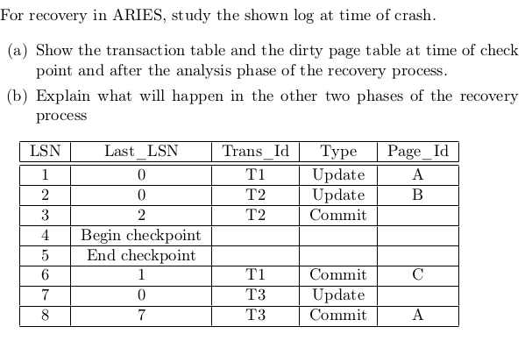
Aries

