Slide 1
WEB BUILDING
Cairo University Faculty of Engineering Computer Engineering Department

Slide 2
PHP Advanced

Slide 3
Agenda
PHP
File Handling
Include/require functions
Cookies
Sessions
Sending E-mails in php
Exceptions in php

Slide 4
File Handling
Opening a file: The fopen() function is used to open files in PHP. The first parameter of this function contains the name of the file to be opened and the second parameter specifies in which mode the file should be opened: Note: If the fopen() function is unable to open the specified file, it returns 0 (false).
<html> <body> <?php $file=fopen("welcome.txt","r"); ?> </body> </html>

Slide 5
File Handling
Closing a file: The fclose() function is used to close an open file
<?php $file = fopen("test.txt","r"); //some code to be executed fclose($file); ?>
Notes:
a append
Create and open for writing only x

Slide 6
File Handling
Check End-of-file: The feof() function checks if the "end-of-file" (EOF) has been reached. The feof() function is useful for looping through data of unknown length. Note: You cannot read from files opened in w, a, and x mode!
if (feof($file)) echo "End of file";

Slide 7
Files Handling
Reading a File Line by Line: The fgets() function is used to read a single line from a file. Note: After a call to this function the file pointer has moved to the next line.
<?php $file = fopen("welcome.txt", "r") or exit("Unable to open file!"); //Output a line of the file until the end is reached while(!feof($file)) { echo fgets($file). "<br />"; } fclose($file); ?>

Slide 8
Files Handling
Reading a File Character by Character: The fgetc() function is used to read a single character from a file. Note: After a call to this function the file pointer moves to the next character.
<?php $file=fopen("welcome.txt","r") or exit("Unable to open file!"); while (!feof($file)) { echo fgetc($file); } fclose($file); ?>

Slide 9
Files Handling
Some functions:
Function | usage
File(filename) | Reads the entire file to an array of lines , key is line number.
file_get_contents(filename ) | Reads entire file to one string
Fgets(file handler ) | Reads one line from a file
Fread(file handler, filesize(filename)) | Reads entire binary file
Fscanf(file handler , format ,variables ) | Reads line from file to specific format and value pairs .
 | Ex: fscanf($fd,"%d %d %d %d",$v1,$v2,$v3,$v4); Reads a line of four integers
Fwrite(file handler , data) | Writes data to a file

Slide 10
Include/require functions
The content of one PHP file can be inserted into another PHP file before the server executes it, with the include() or require() function. These two functions are identical in every way, except how they handle errors: - include() generates a warning, but the script will continue execution -require() generates a fatal error, and the script will stop They are used to create functions, headers, footers, or elements that will be reused on multiple pages.
Notes:
Server side includes saves a lot of work.
- You can create a standard header, footer, or menu file for all your web pages.
- When the header needs to be updated, you can only update the include file, or when you add a new page to your site, you can simply change the menu file (instead of updating the links on all your web pages).

Slide 11
Include function
It takes all the content in a specified file and includes it in the current file. If an error occurs, the include() function generates a warning, but the script will continue execution.

Slide 12
Include function – Example 1
Assume that you have a standard header file, called "header.php". To include the header file in a page, use the include() function:
<html> <body> <?php include("header.php"); ?> <h1>Welcome to my home page!</h1> <p>Some text.</p> </body> </html>

Slide 13
Include function – Example 2
Assume we have a standard menu file, called "menu.php", that should be used on all pages: All pages in the website should include this menu file. Here is how it can be done:
<a href="/default.php">Home</a> <a href="/tutorials.php">Tutorials</a> <a href="/references.php">References</a> <a href="/examples.php">Examples</a> <a href="/about.php">About Us</a> <a href="/contact.php">Contact Us</a>
<div class="leftmenu"> <?php include("menu.php"); ?> </div> <h1>Welcome to my home page.</h1> <p>Some text.</p>

Slide 14
require function – Example
It is identical to include(), except that it handles errors differently. If an error occurs, it generates a fatal error, and the script will stop. The echo statement is not executed, because the script execution stopped after the fatal error.
<html> <body> <?php require("wrongFile.php"); echo "Hello World!"; ?> </body> </html>
Error Message:
Warning: require(wrongFile.php) [function.require]: failed to open stream: No such file or directory in C:\home\website\test.php on line 5 Fatal error: require() [function.require]: Failed opening required 'wrongFile.php' (include_path='.;C:\php5\pear') in C:\home\website\test.php on line 5

Slide 15
Cookies
Used to identify a user. A small file that the server embeds on the user's computer. Each time the same computer requests a page with a browser, it will send the cookie too. With PHP, you can both create and retrieve cookie values.
The setcookie() function is used to set a cookie. Note: The setcookie() function must appear BEFORE the <html> tag. setcookie(name, value, expire, path, domain)
Notes:
pathThe path on the server in which the cookie will be available on. If set to '/', the cookie will be available within the entire domain. If set to '/foo/', the cookie will only be available within the /foo/ directory and all sub-directories such as /foo/bar/ of domain. The default value is the current directory that the cookie is being set in.
domainThe (sub)domain that the cookie is available to. Setting this to a subdomain (such as 'www.example.com') will make the cookie available to that subdomain and all other sub-domains of it (i.e. w2.www.example.com). To make the cookie available to the whole domain (including all subdomains of it), simply set the value to the domain name ('example.com', in this case).

Slide 16
Create a Cookie - Example
We will create a cookie named "user" and assign the value "Alex" to it. We also specify that the cookie should expire after one hour(3600 second): Note: The value of the cookie is automatically URLencoded when sending the cookie, and automatically decoded when received (to prevent URLencoding, use setrawcookie() instead).
<?php setcookie("user", "Alex ", time()+3600); ?> <html>
….

Slide 17
Retrieve a Cookie
The PHP $_COOKIE variable is used to retrieve a cookie value. In the example below, we retrieve the value of the cookie named "user" and display it on a page:
<?php // Print a cookie echo $_COOKIE["user"]; // A way to view all cookies print_r($_COOKIE); ?>
Notes:
print_r() function is a built-in function in PHP and is used to print or display information stored in a variable

Slide 18
Cookies - Example
In this example we use the isset() function to find out if a cookie has been set:
<html> <body> <?php if (isset($_COOKIE["user"])) echo "Welcome " . $_COOKIE["user"] . "!<br />"; else echo "Welcome guest!<br />"; ?> </body> </html>
Notes:
print_r : - outputs human-readable representation of any one value. - outputs an array showing keys and values. - has a return type.(can be used in an expression). - takes not just string but any value. echo : - prints a string or a concatenated string - doesnt have a return type

Slide 19
Delete a Cookie
When deleting a cookie you should assure that the expiration date is in the past.
<?php // set the expiration date to one hour ago setcookie("user", "", time()-3600); ?>
Notes:
Common uses for cookies include authentication, storage of site preference
So, if you have a site requiring a login, that information is better served as a cookie, or the user would be forced to log in every time he visits. If you prefer tighter security, sessions work best.

Slide 20
Sessions
A PHP session is a way to store information (in variables) to be used across multiple pages. Session variables hold information about one single user, and are available to all pages in one application. It works like a token allowing access and passing information while the user has their browser open. when you close your browser you lose the session. Unlike cookies, session variables are stored in the web server.
Notes:
A session is a way to store information (in variables) to be used across multiple pages.
Unlike a cookie, the information is not stored on the users compute

Slide 21
Sessions
The computer knows who you are. It knows when you start the application and when you end. But on the internet there is one problem: the web server does not know who you are and what you do because the HTTP address doesn't maintain state. A PHP session solves this problem by allowing you to store user information on the server for later use (i.e. username, shopping items, etc). However, session information is temporary and will be deleted after the user has left the website. If you need a permanent storage you may want to store the data in a database. Sessions work by creating a unique id (UID) for each visitor and store variables based on this UID. The UID is either stored in a cookie or is propagated in the URL.

Slide 22
Starting a Session
Before you can store user information in your PHP session, you must first start up the session. Note: The session_start() function must appear BEFORE the <html> tag: The code above will register the user's session with the server, allow you to start saving user information, and assign a UID or a username for that user's session.
<?php session_start(); ?> <html> <body> $_SESSION['login_user']= $username;
echo $_SESSION['login_user']; </body> </html>
Notes:
A cookie is a bit of data stored by the browser and sent to the server with every request.
A session is a collection of data stored on the server and associated with a given user

Slide 23
Storing a Session Variable
The correct way to store and retrieve session variables is to use the PHP $_SESSION variable:
<?php session_start(); // store session data $_SESSION['views']=1; ?> <html> <body> <?php //retrieve session data echo "Pageviews=". $_SESSION['views']; ?> </body> </html>
Output:
Page views=1

Slide 24
Storing a Session Variable
In this example, we create a simple page-views counter. The isset() function checks if the "views" variable has already been set. If "views" has been set, we can increment our counter. If "views" doesn't exist, we create a "views" variable, and set it to 1:
<?php session_start(); if(isset($_SESSION['views'])) $_SESSION['views']=$_SESSION['views']+1; else $_SESSION['views']=1; echo "Views=". $_SESSION['views']; ?>

Slide 25
Destroying a Session Variable
If you wish to delete some session data, you can use the unset() or the session_destroy() function. The unset() function is used to free the specified session variable: You can also completely destroy the session by calling the session_destroy() function:
<?php unset($_SESSION['views']); ?>
<?php session_destroy(); ?>

Slide 26
Sending Email using PhP
PHP allows you to send e-mails directly from a script. The PHP mail() function is used to send emails from inside a script. mail(to,subject,message,headers,parameters) To : Required. Specifies the receiver / receivers of the email Subject : Required. Specifies the subject of the email. Note: This parameter cannot contain any newline characters Message: Required. Defines the message to be sent. Each line should be separated with a LF (\n). Lines should not exceed 70 characters Headers: Optional. Specifies additional headers, like From, Cc, and Bcc. The additional headers should be separated with a CRLF (\r\n) Parameters: Optional. Specifies an additional parameter to the sendmail program

Slide 27
Email
Note: For the mail functions to be available, PHP requires an installed and working email system. The program to be used is defined by the configuration settings in the php.ini file.

Slide 28
Sending Email - Example
<?php $to = "someone@example.com"; $subject = "Test mail"; $message = "Hello! This is a simple email message."; $from = "someonelse@example.com"; $headers = "From: $from"; mail($to,$subject,$message,$headers); echo "Mail Sent."; ?>

Slide 29
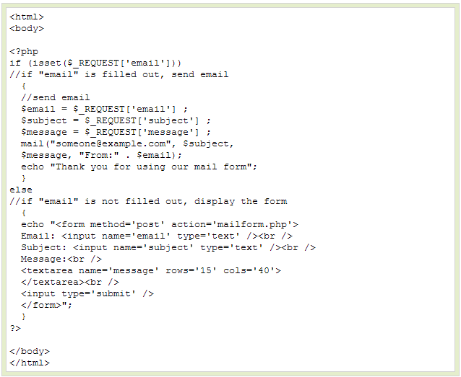

Slide 30
Sending Secure Email - Example
function spamcheck($field) { //filter_var() function filters a variable with the specified filter. //Here, it filters the e-mail address using FILTER_SANITIZE_EMAIL
//to remove any illegal characters from the e-mail string. $field=filter_var($field, FILTER_SANITIZE_EMAIL); //filter_var() validates if the e-mail address is a valid one or not. //address using FILTER_VALIDATE_EMAIL if(filter_var($field, FILTER_VALIDATE_EMAIL)) { return TRUE; } else { return FALSE; } }
Notes:
This function checks if it is a valid e-mail address or not
The FILTER_SANITIZE_EMAIL filter removes all illegal characters from an email address
The FILTER_VALIDATE_EMAIL filter validates value as an e-mail address

Slide 31
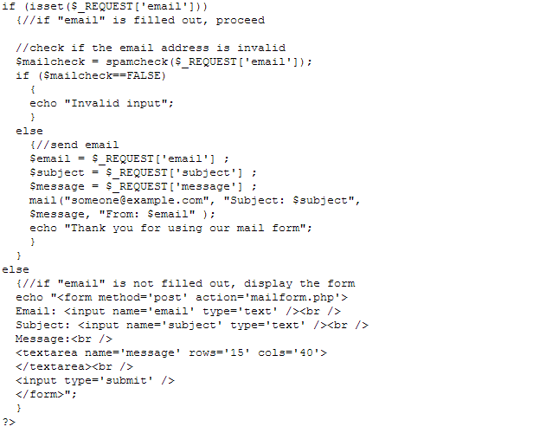

Slide 32
Exception Handling
Exception handling is used to change the normal flow of the code execution if a specified error (exceptional) condition occurs. We will show different error handling methods: - Basic use of Exceptions - Creating a custom exception handler - Multiple exceptions

Slide 33
Basic Use of Exceptions
Proper exception code should include: - Try - A function using an exception should be in a "try" block. If the exception does not trigger, the code will continue as normal. However if the exception triggers, an exception is "thrown“. - Throw - This is how you trigger an exception. - Catch - A "catch" block retrieves an exception and creates an object containing the exception information

Slide 34
Basic Use of Exceptions- Example
<?php //create function with an exception function checkNum($number) { if($number>1) { throw new Exception("Value must be 1 or below"); } return true; } //trigger exception in a "try" block try { checkNum(2); //If the exception is thrown, this text will not be shown echo 'If you see this, the number is 1 or below'; } //catch exception catch(Exception $e) { echo 'Message: ' .$e->getMessage(); }?>
Output:
Message: Value must be 1 or below

Slide 35
Creating a Custom Exception Class
<?php class customException extends Exception { public function errorMessage() { //error message $errorMsg = 'Error on line '.$this->getLine().' in '.$this->getFile() .': <b>'.$this->getMessage().'</b> is not a valid E-Mail address'; return $errorMsg; } } $email = "someone@example...com"; try { //check if if(filter_var($email, FILTER_VALIDATE_EMAIL) === FALSE) { //throw exception if email is not valid throw new customException($email); } }
catch (customException $e)
{
//display custom message
echo $e->errorMessage();
}
?>

Slide 36
Creating a Custom Exception Class
The new class is a copy of the old exception class with an addition of the errorMessage() function. Since it is a copy of the old class, and it inherits the properties and methods from the old class, we can use the exception class methods like getLine() and getFile() and getMessage().

Slide 37
Multiple Exception
//check for "example" in mail address
if(strpos($email, "example") !== FALSE)
{
throw new Exception("$email
is an example e-mail");
}
}
catch (customException $e)
{
echo $e->errorMessage();
}
catch(Exception $e)
{
echo $e->getMessage();
}
?>
<?php class customException extends Exception { public function errorMessage() { //error message $errorMsg = 'Error on line '.$this->getLine().' in '.$this->getFile() .': <b>'.$this->getMessage().'</b> is not a valid E-Mail address'; return $errorMsg; } } $email = "someone@example.com"; try { //check if if(filter_var($email, FILTER_VALIDATE_EMAIL) === FALSE) { //throw exception if email is not valid throw new customException($email); }

