Slide 1
Approximating weighted vertex cover using linear programming
Presented to: Dr. Mayada Hadhoud
Prepared by: Bishoy Aziz

Slide 2
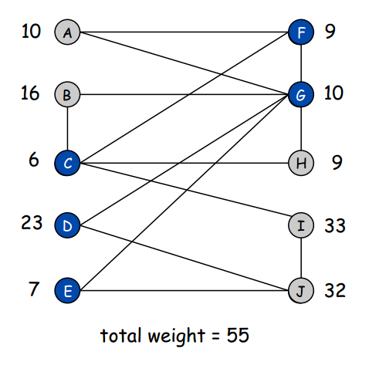
minimum-weight vertex-cover problem
Given an undirected graph G = (V, E)
vertex weights wi≥0
find a minimum weight subset of nodes C such that every edge is incident to at least one vertex in C.

Slide 3
Weighted Vertex Cover: IP Formulation

Slide 4
Weighted Vertex Cover: IP Formulation

Slide 5
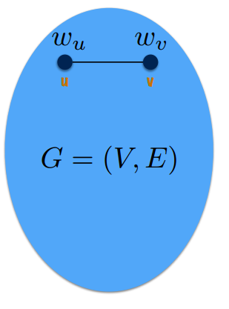
Weighted Vertex Cover: IP Formulation

Slide 6
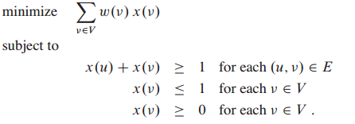
linear-programming relaxation
Notes:
LP is not equivalent to vertex cover

Slide 7
Algorithm

Slide 8
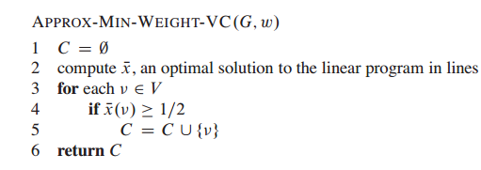
Algorithm

Slide 9
Runtime
Algorithm APPROX-MIN-WEIGHT-VC is a polynomial-time because:
There is a polynomial-time algorithm to solve the linear program.
The for loop of lines 3–5 runs in polynomial time

Slide 10
Correctness

Slide 11
Cost
APPROX-MIN-WEIGHT-VC is a 2-approximation algorithm.
C* : an optimal solution to the minimum-weight vertex-cover problem.
Z* : the value of an optimal solution to the linear program.
Z* <= w(C* ) ---------(1)
Because LP has fewer constraints
Notes:
Since an optimal vertex cover is a feasible solution to the
linear program z* must be a lower bound on w(c*)

Slide 12
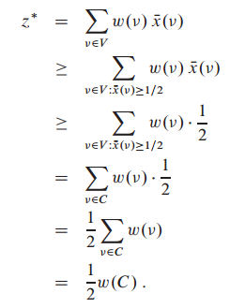
Cost
-------(2)

Slide 13
Cost
From (1) and (2)

Slide 14
References
Introduction to Algorithms, THOMAS H. CORMEN, CHARLES E. LEISERSON, RONALD L . RIVEST, CLIFFORD STEIN , 3rd edition.
Coursera: Approximation Algorithms Part I

