Slide 1
WEB BUILDING
Cairo University Faculty of Engineering Computer Engineering Department

Slide 2
Agenda
HTML Forms
Browser Scripting → Javascript

Slide 3
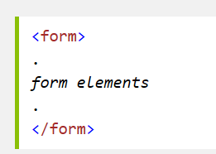
HTML Forms
HTML forms are used to collect user input.
The <form> element defines an HTML form:
HTML forms contain form elements: Form elements are different types of input elements
The <input> element has many variations, depending on the type attribute.

Slide 4
The Input Element types
Notes:
To set default value, use the property (value = "5“)

Slide 5
The Input Element - Text Fields
<input type="text" />
<html> <body>
<form> First name: <input type="text" name="firstname"/><br/> Last name: <input type="text" name="lastname" /> </form> </body>
</html>
Notes:
The name attribute is used to reference elements in a JavaScript, or to reference form data after a form is submitted.
[Note]: Only form elements with a name attribute will have their values passed when submitting a form.

Slide 6
The Input Element-Password Field
<input type=“password" />
<html> <body>
<form> Password: <input type="password" name="pwd" /> </form> </body>
</html>
******

Slide 7
The Input Element- Radio Buttons
<input type=“radio" />
<html> <body>
<form> <input type="radio" name=“gender ” checked/> Male<br /> <input type="radio“ name=“gender” /> Female </form> </body>
</html>

Slide 8
The Input Element- Submit Button
<input type=“submit" />
<html> <body>
<form name="input" action="html_form_action.asp" method="get"> Username: <input type="text" name="user" /> <input type="submit" value="Submit" /> </form>
</body>
</html>
Notes:
action: URLSpecifies where to send the form-data when a form is submitted (when the submit button is clicked) method: get, post Specifies the HTTP method to use when sending form-data The form-data can be sent as URL variables (with method="get") or as HTTP post transaction (with method="post").
[ Notes on GET ]:
Appends form-data into the URL in name/value pairs
The length of a URL is limited (about 3000 characters)
Never use GET to send sensitive data! (will be visible in the URL)
Useful for form submissions where a user want to bookmark the result
GET is better for non-secure data, like query strings in Google.
[ Notes on POST ]:
Appends form-data inside the body of the HTTP request (data is not shown is in URL)
Has no size limitations.
Form submissions with POST cannot be bookmarked.

Slide 9
The Input Element- Submit Button
<input type="submit"> defines a button for submitting the form to a form-handler.
The form-handler is typically a server page with a script for processing input data.
The form-handler is specified in the form's action attribute.
If the action attribute is omitted, the action is set to the current page.
The method attribute specifies the HTTP method (GET or POST) to be used when submitting the forms:
[ Get ]:
the default method.
If the form submission is passive (like a search engine query), and without sensitive information.
When you use GET, the form data will be visible in the page address
[ Post ]:
If the form is updating data, or includes sensitive information (password).
POST offers better security because the submitted data is not visible in the page address.

Slide 10
Get method example

Slide 11
The Input Element- Submit Button
Take Care
To be submitted correctly, each input field must have a name attribute

Slide 12
The <select> Element (Drop-Down List)
<html>
<body>
<form action="">
<select name="cars">
<option value="volvo"> Volvo </option>
<option value="saab"> Saab </option>
<option value="fiat"> Fiat </option>
<option value="audi" selected> Audi </option>
</select>
</form>
</body>
</html>
The <option> elements defines the options to select.
The list will normally show the first item as selected.
You can add a selected attribute to define a predefined option.

Slide 13
The <button> Element
<html>
<body>
<button type="button" onclick="alert('Hello World!')">
Click Me!</button>
</body>
</html>

Slide 14
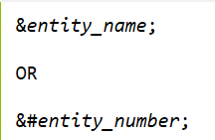
HTML Entities
Reserved characters (for example ‘ < ‘) in HTML must be replaced with character entities.
Characters, not present on your keyboard, can also be replaced by entities.
A character entity looks like this:
The advantage of using an entity name, instead of a number, is that the name is easier to remember. The disadvantage is that browsers may not support all entity names, but the support for numbers is good.

Slide 15
HTML Useful Character Entities
Note: Entity names are case sensitive!

Slide 16
HTML Meta Element
Metadata is data (information) about data.
The <meta> tag provides metadata about the HTML document. Metadata will not be displayed on the page, but will be machine parsable.
Meta elements are typically used to specify page description, keywords, author of the document, last modified, and other metadata.
The metadata can be used by browsers (how to display content or reload page), search engines (keywords), or other web services.

Slide 17
The HTML Meta Element
The following meta element defines a description of a page:
The following meta element defines keywords for a page:
<head>
<meta name="description" content="Free Web tutorials on HTML, CSS, XML" />
</head>
<head>
<meta name="keywords" content="HTML, CSS, XML" />
</head>

Slide 18
The HTML meta Element-Redirect to a new web address
<html>
<head>
<meta http-equiv="Refresh" content="5;url=http://www.google.com" />
</head>
<body>
<h1>Sorry! We have moved!</h1>
<h2>The new URL is:
<a href="http://www.google.com">http://www.google.com</a>
</h2>
<p>You will be redirected to the new address in five seconds.</p>
</body>
</html>

Slide 19
Browser Scripting JavaScript

Slide 20
JavaScript
A scripting language which is a lightweight programming language
Designed to add interactivity to HTML pages
It is usually embedded directly into HTML pages
It is an interpreted language (means that scripts execute without preliminary compilation)
Scripts in an HTML file are executed on the client (in the browser)

Slide 21
Why JavaScript?
Add dynamic text into an HTML page .
React to events :
It can be set to execute when something happens
Read and write HTML elements .
Validate data .
Detect the visitor's browser .
Create cookies.

Slide 22
JavaScript in an HTML page
<html>
<body>
<script type="text/javascript">
document.write("Hello World!"); document.write("<h1> add HTML tags to the JavaScript </h1>");
</script>
</body>
</html>

Slide 23
Where to put the JavaScript?
JavaScripts in a page will be executed immediately while the page loads into the browser.
In <head> :
Scripts to be executed when they are called, or when an event is triggered, are placed in functions.
Put your functions in the head section, this way they are all in one place, and they do not interfere with page content.
In <body> :
If you don't want your script to be placed inside a function.
Or if your script should write page content.

Slide 24
Scripts in <head> - Example
<html>
<head>
<script type="text/javascript">
function message()
{
alert("This alert box was called with the onload event");
}
</script>
</head>
<body onload="message()">
</body>
</html>

Slide 25
External JavaScript
If you want to run the same JavaScript on several pages, without having to write the same script on every page, you can write a JavaScript in an external file.
Save the external JavaScript file with
a .js file extension.
The external script cannot contain the <script></script>
<html> <body>
<script type="text/javascript" src=“script-file.js">
</script>
<p>This script is in an external script file called “script-file.js".</p>
</body> </html>

Slide 26
JavaScript Statements
JavaScript is Case Sensitive ( Unlike HTML )
The semicolon is optional (according to the JavaScript standard), and the browser is supposed to interpret the end of the line as the end of the statement.
document.write ( "Hello Dolly" )
Note: Using semicolons makes it possible to write multiple statements on one line.
Single-line comments start with //
Multi-line comments start with /* and end with */

Slide 27
Declaring Variables
You can declare variables with the var keyword.
var x = 10; var name = “XYZ”;
var y;
If you assign values to variables that have not yet been declared, the variables will automatically be declared.
These statements: x=10; name=“XYZ"; | Have the same effect as: var x=10; var name=“XYZ";

Slide 28
Redeclaring Variables
If you redeclare a variable, it will not lose its original value.
var x=10; var x; // still equal 10
After the execution of the statements above, the variable x will still have the value of 10.
The value of x is not reset.

Slide 29
JavaScript Operators
Given that y=5, this table explains arithmetic operators:
Given that x = 10 and y=5, this table explains assignment operators:

Slide 30
JavaScript Operators
Given that x=5, this table explains comparison operators:
Given that x=6 and y=3, this table explains logical operators:

Slide 31
JavaScript Operators
+ Operator on Strings
It can be used to add string variables or text values together (concatenate strings).
To add two or more string variables together:
txt1 = “Good "; txt2 = “Morning"; txt3 = txt1 + txt2;
txt3 → “Good Morning”

Slide 32
JavaScript Operators
+ Operator on Strings
Note:
If you add a number and a string, the result will be a string !
x= 5 + "5“ ;
document.write ( x ) ;
x → “55”

Slide 33
JavaScript Operators
Conditional Operator
It is used to assign a value to a variable based on some condition.
Syntax:
variablename = (condition) ? value1 : value2
Example
greeting = (visitor=="PRES") ? "Dear President " : "Dear" ;

Slide 34
JS Conditional Statements IF … Else IF … Else
If Statement | If...else Statement | If...else if…else Statement
if (condition) { code to be executed if condition is true } | if (condition) { code to be executed if condition is true } else { code to be executed if condition is not true } | if (condition1) { code to be executed if condition1 is true } else if (condition2) { code to be executed if condition2 is true } else { code to be executed if condition1 and condition2 are not true }

Slide 35
JS Conditional Statements IF…Else Example
<html> <body> <script type="text/javascript">
/* Checks the time on your browser if it is less than 10 */
var d = new Date();
var time = d.getHours();
if (time < 10)
{ document.write("<b>Good morning</b>");
}
else
{ document.write("<b>Good day</b>");
}
document.write("<br\><br\>Current time is: "+d);
</script>
</body>
</html>

Slide 36
JS Conditional Statements Switch Statement - Example
switch ( n ) { case 1: execute code block 1 break; case 2: execute code block 2 break; default: otherwise }
<script type="text/javascript">
var d = new Date();
theDay=d.getDay();
switch (theDay)
{ case 5:
document.write("<b>Finally Friday</b>");
break;
case 6:
document.write("<b>Super Saturday</b>");
break;
default:
document.write("<b>I'm really looking forward to
this weekend!</b>");
} </script>

Slide 37
JS Popup Boxes
Alert box
Used if you want to make sure information comes through to the user.
Confirm box
Used if you want the user to verify or accept something.
Prompt box
Used if you want the user to input a value before entering a page.
When an alert box pops up, the user will have to click "OK" to proceed. alert ("sometext") ;
When a confirm box pops up, the user will have to click either "OK" or "Cancel" to proceed.
If the user clicks "OK", the box returns true. If the user clicks "Cancel", the box returns false. confirm ("sometext") ;
When a prompt box pops up, the user will have to click either "OK" or "Cancel" to proceed after entering an input value.
If the user clicks "OK" the box returns the input value. If the user clicks "Cancel" the box returns null. prompt ("sometext“ , "defaultvalue") ;

Slide 38
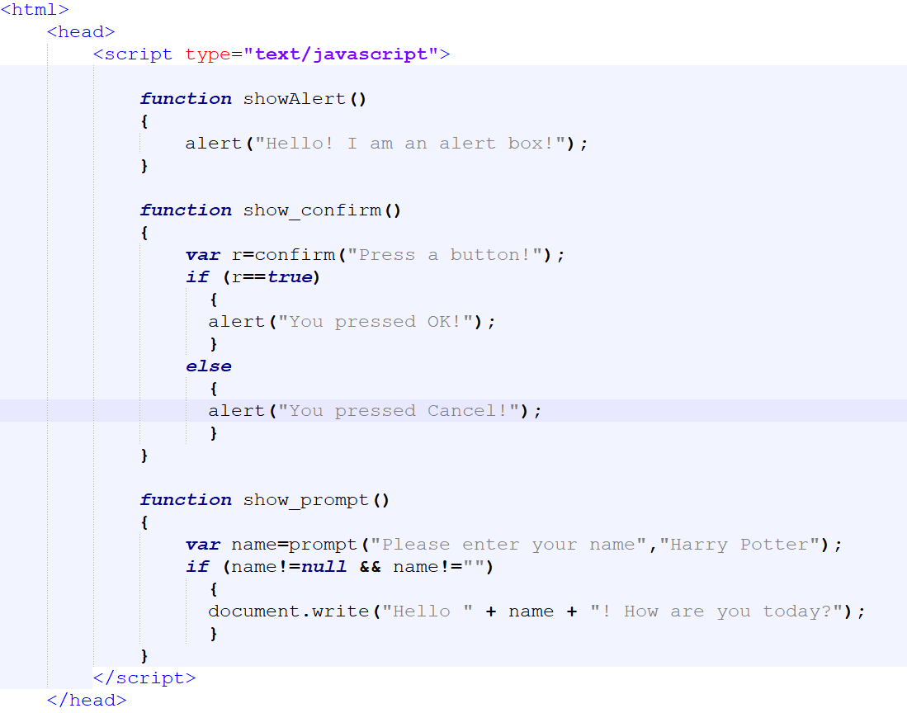
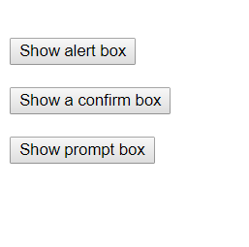
JS Popup Boxes - Example

Slide 39
JS Functions
Syntax:
function functionname ( var1, var2 , ... , varX ) { some code }
Example:
function product ( a , b )
{
return a*b;
}

Slide 40
JS Functions – return Statement Example
<html> <head>
<script type="text/javascript">
function product(a,b)
{ return a*b;
}
</script>
</head>
<body>
<script type="text/javascript">
document.write( product(4,3) );
</script>
<p>The script in the body section calls a function with two parameters (4 and 3).</p>
</body> </html>

Slide 41
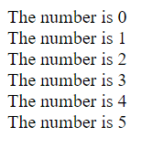
JS Loops-For Loop
Syntax:
for(var=start; var<=end; var+=inc)
{ code to be executed
}
<script type="text/javascript">
for (i = 0; i <= 5; i++)
{
document.write("The number is " + i);
document.write("<br />");
}
</script>

Slide 42
JS Loops-While Loop
Syntax:
while (var<=endvalue) { code to be executed }
<script type="text/javascript">
i=0;
while (i<=5)
{
document.write("The number is " + i);
document.write("<br />");
i++;
}
</script>

Slide 43
JS Loops-Do While Loop
Syntax:
do { code to be executed } while (var<=endvalue);
<script type="text/javascript">
i = 0;
do
{
document.write("The number is " + i);
document.write("<br />");
i++;
} while (i <= 5);
</script>

Slide 44
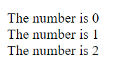
JS Break and Continue Statements
The break statement will break the loop and continue executing the code that follows after the loop (if any).
The continue statement will break the current loop and continue with the next value.
<script type="text/javascript">
var i=0;
for (i=0;i<=10;i++)
{ if (i==3)
{ break; // what if we put continue? Will the output change??
}
document.write( "The number is " + i );
document.write("<br />");
}
</script>

Slide 45
JS For...In Statement
Syntax:
for (variable in object) { code to be executed }
<script type="text/javascript">
var x;
var mycars = new Array();
mycars[0] = "Saab";
mycars[1] = "Volvo";
mycars[2] = "BMW";
for ( x in mycars )
{ document.write(mycars[x] + "<br />");
}
</script>

Slide 46
JS Events
By using JavaScript, we have the ability to create dynamic web pages. Events are actions that can be detected by JavaScript.
Every element on a web page has certain events which can trigger a JavaScript.
Examples of events:
A mouse click
A web page or an image loading
Mousing over a hot spot on the web page
Selecting an input field in an HTML form
Submitting an HTML form

Slide 47
JS Events - Example
onSubmit event
It is usually used to validate ALL form fields on client side before submitting it to the server.
Example:
<form name="myForm" onsubmit="return validateForm()" method="post">
The validateForm() function is a user-defined function that will be called when the user clicks the submit button in the form. If the field values are not accepted, the submit should be cancel.

Slide 48
JS “onsubmit” Event - Example
<!DOCTYPE html> <html>
<head> <script>
function validateForm() {
var x = document.forms ["myForm"] ["fname"] . value;
if (x == "") {
alert("Name must be filled out");
return false;
}
var y = document.forms ["myForm"] ["rd_gender"] . value; // y now containsthe value attribute of the checked radio button item // from the radio button group that has “rd_gender” name.
alert("Name: " + x + ", Gender: " + y);
}
</script> </head>
Notes:
“myForm” is the “name” attribute of the form.
“fname” and “rd_gender” is the “name” attribute of the input text and radio buttons respectively.
[ Notes ]:
- we give the same “name” attribute value to all the radio buttons of the same group.
- var y = document.forms ["myForm"] ["rd_gender"] . value;
will return the “value” attribute of the checked radio button.

Slide 49
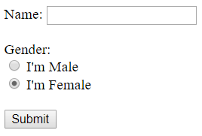
JS “onsubmit” Event - Example
<body>
<form name="myForm" onsubmit="return validateForm()" method="post">
Name: <input type="text" name="fname"> <br><br>
Gender: <br>
<label>
<input type="radio" name="rd_gender" value="Male"> I'm Male
</label> <br>
<label>
<input type="radio" name="rd_gender" value="Female" checked> I'm Female
</label> <br> <br>
<input type="submit" value="Submit">
</form>
</body> </html>

Slide 50
JS Try…Catch
The try...catch statement allows you to test a block of code for errors.
The try block contains the code to be run,
The catch block contains the code to be executed if an error occurs.
Syntax:
try { //Run some code here } catch(err)
{ //Handle errors here
}

Slide 51
JS Try..Catch - Example
<!DOCTYPE html> <html>
<head> <script>
function message()
{ try
{ adddlert("Welcome guest!"); //error syntax
}
catch ( err )
{ alert ( "Error Message: " + err.message );
}
}
</script> </head>
<body>
<button type="button" onclick="message()">Test</button>
</body> </html>

Slide 52
JS Throw Statement
It allows you to create an exception. If you use this statement together with the try...catch statement, you can control program flow and generate accurate error messages.
The exception can be a string, integer, Boolean or an object.
Syntax:
throw ( exception )

Slide 53
JS Throw Statement - Example
<html>
<body>
<script type="text/javascript">
var x=prompt("Enter a number between 0 and 10:“ , "" );
try
{ if(x>10 || x<0)
{ throw "Err1";
}
else if (isNaN(x)) // isNAN() -> is not a number
{ throw "Err3";
}
}
catch(er)
{ if ( er == "Err1“ )
{ alert("Error! Wrong val");
}
if ( er == "Err3“ )
{ alert("Error! Not a number");
}
}
</script>
</body>
</html>

Slide 54
JS Objects
JS is an Object Oriented Programming (OOP) language.
An object has properties and methods.
Properties are the values associated with an object.
Methods are the actions that can be performed on objects.

Slide 55
Built-in JS objects
For example,
JS String
JS Date
JS Array
JS Boolean
Js Math
JS RegExp

Slide 56
Built-in JS objects String Object
Properties
ex.:
var txt = "Hello World!"; document.write( txt.length );
The output will be: 12
Methods
ex.:
var str = "Hello world!"; document.write( str.toUpperCase( ) );
The output will be: HELLO WORLD!

Slide 57
Built-in JS objects Array Object
Create an Array object
// regular array (add an optional integer) var myCars = new Array( );
myCars[0] = "Saab";
myCars[1] = "Volvo";
myCars[2] = "BMW";
var myCars = new Array ( "Saab","Volvo","BMW" ); // condensed array
var myCars=["Saab","Volvo","BMW"]; // literal array
Note: Arrays in javascript are not a sequential allocation of memory, but objects with enumerable property names and a few extra useful methods.

Slide 58
Built-in JS objects Array Object
<html>
<body>
<script type="text/javascript">
var parents = ["Jani", "Tove"];
var children = ["Cecilie", "Lone"];
var family =
parents.concat( children );
document.write( family );
</script>
</body>
</html>
Access an Array:
document.write(myCars[0]);
Modify Values in an Array:
myCars[0]="Opel";

Slide 59
Built-in JS objects Date Object
To instantiate a date:
new Date() // current date and time
new Date(milliseconds) //milliseconds since 1970/01/01
new Date(dateString)
new Date(year, month, day, hours, minutes, seconds, milliseconds)
Examples:
today = new Date()
d1 = new Date("October 13, 1975 11:13:00")
d2 = new Date(79,5,24)
d3 = new Date(79,5,24,11,33,0)

Slide 60
Built-in JS objects Date Object
To set a Date object to a specific date e.g. (14th January 2010):
var myDate1= new Date( ); myDate1.setFullYear(2010,0,14);
To set a Date object to be 5 days into the future:
var myDate2=new Date(); myDate2.setDate( myDate.getDate( ) + 5);
To Compare dates:
if ( myDate1 > myDate2 ) {…}
Note: If adding five days to a date shifts the month or year, the changes are handled automatically by the Date object itself!

Slide 61
JS Create Your own Object
Create a direct instance of an object :
personObj = new Object();
The following code creates an instance of an object and adds four properties to it: personObj.firstname = "John"; personObj.lastname = "Doe"; personObj.age = 50; personObj.eyecolor = "blue";
The following code adds a method called eat() to the personObj:
personObj.eat = eat;

Slide 62
JS Create Your own Object
Create a template of an object :
The template defines the structure of an object:
function person ( firstname , lastname , age , eyecolor ) { this.firstname = firstname; this.lastname = lastname; this.age = age; this.eyecolor = eyecolor; this.newlastname = newlastname; // a method }

Slide 63
JS Create Your own Object
Methods are just functions attached to objects.
We have to write the newlastname() function used in the previous slide:
function newlastname( new_lastname ) { this.lastname = new_lastname; }
You can create new instances of the object, like this:
myFather = new person ("John","Doe",50,"blue");
myMother = new person ("Sally","Rally",48,"green");
myMother.newlastname( "Doe“ );

Slide 64
JS Browser Detection
The Navigator object contains information about the visitor's browser name, version, and more.

Slide 65
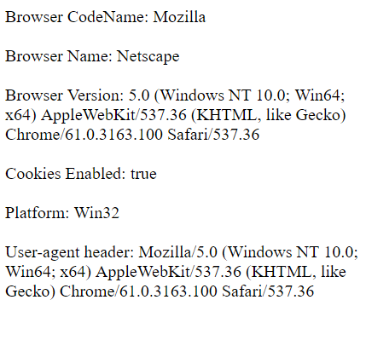
JS Browser Detection
<html> <body>
<script type="text/javascript">
document.write("Browser CodeName: " + navigator.appCodeName);
document.write("<br /><br />");
document.write("Browser Name: " + navigator.appName);
document.write("<br /><br />");
document.write("Browser Version: " + navigator.appVersion);
document.write("<br /><br />");
document.write("Cookies Enabled: " + navigator.cookieEnabled);
document.write("<br /><br />");
document.write("Platform: " + navigator.platform);
document.write("<br /><br />");
document.write("User-agent header: " + navigator.userAgent);
</script>
</body> </html>

Slide 66
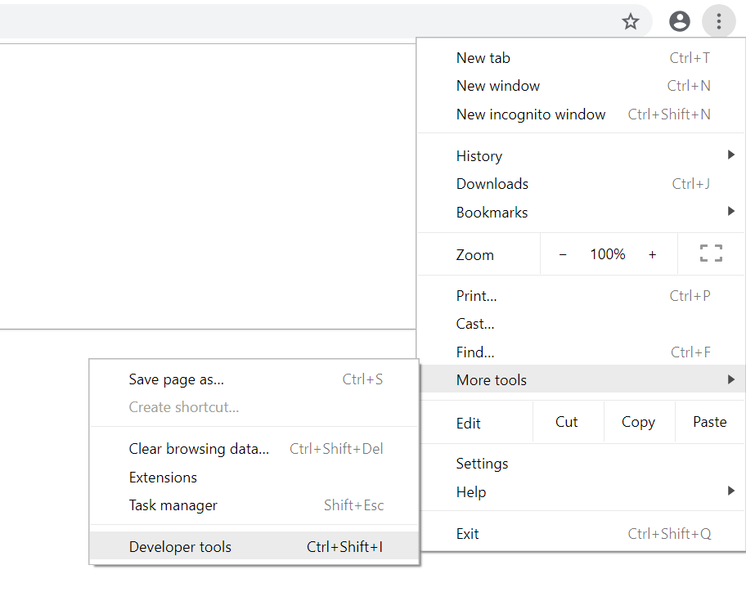
Javascript Debugging in Google Chrome
From “More Tools”, select “Developer Tools”
OR press: Ctrl + Shift + I OR F12
From “Console”, you can view if any errors occurs.
If you click on the line number beside the error, you will automatically go to this line.

Slide 67
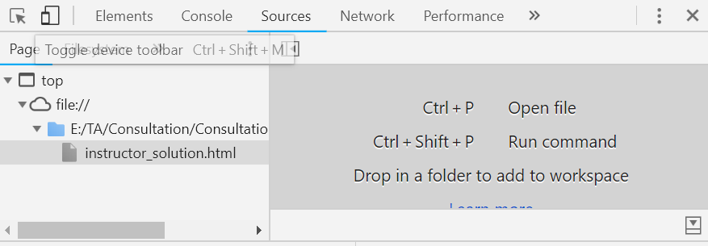
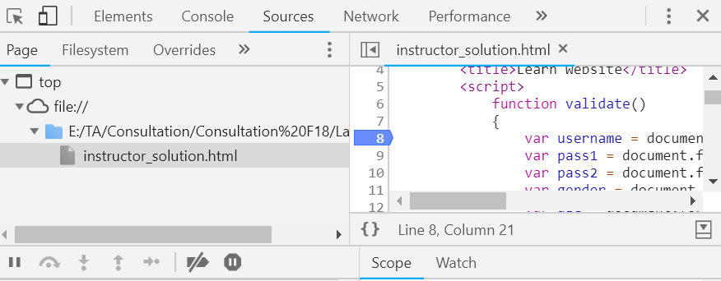
Javascript Debugging in Google Chrome
You open the source file to be able to debug step by step.
Click on the “Sources”, then double click the file that contains your script.
You can add breakpoint by clicking on the line number as shown OR click on the line then press: Ctrl + B
Note: if your code will be executed when a button is clicked, you have to click on the button to reach your breakpoint.
When you reach the breakpoint you can execute the next line by pressing: F10 normally.

