Slide 1
WEB BUILDING USING Framework
Cairo University Faculty of Engineering Computer Engineering Department
CMPN 425-Fall 2018

Slide 2
Laravel – PHP Framework

Slide 3
Agenda
What is Laravel and Why Laravel ?
Basics of any web framework
Basics of Laravel
Project Structure
Routing
Controllers
Views and Blade Templating
Databases & ORM (models)
Form Handling Examples

Slide 4
What is Laravel ?
Laravel is a free open-source PHP Web framework, intended for the development of web application following the model-view-controller (MVC) Architectural pattern.
Laravel is a web application framework with expensive, elegant syntax.
Laravel attempts to take the pain out.

Slide 5
Why Laravel?
Expressive, beautiful syntax, Simplicity and readability
Tailored for your team, Whether you’re a solo developer or a 20 person team, Laravel keeps everyone in sync using Laravel’s database agnostic migrations and schema builder.
Amazing ORM, painless routing, maintainable PHP

Slide 6
MVC - Architecture

Slide 7
ORM
Object-relational mapping (ORM, O/RM, and O/R mapping tool) in computer science is a programming technique for converting data between incompatible type systems using object-oriented programming languages. This creates, in effect, a "virtual object database" that can be used from within the programming language.

Slide 8
Project Structure

Slide 9
Project Structure

Slide 10
Routing

Slide 11
Routing

Slide 12
Controllers

Slide 13
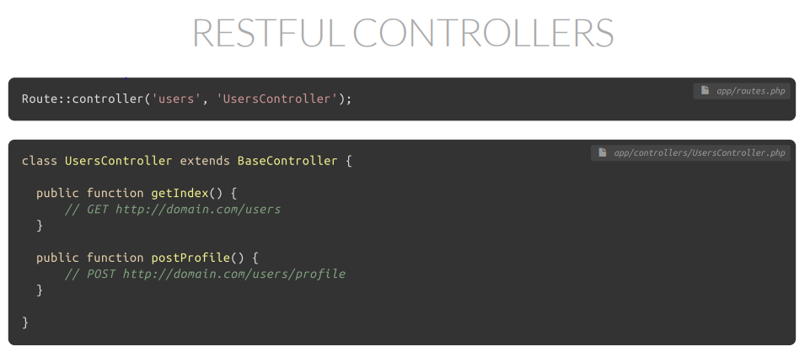
Controllers

Slide 14
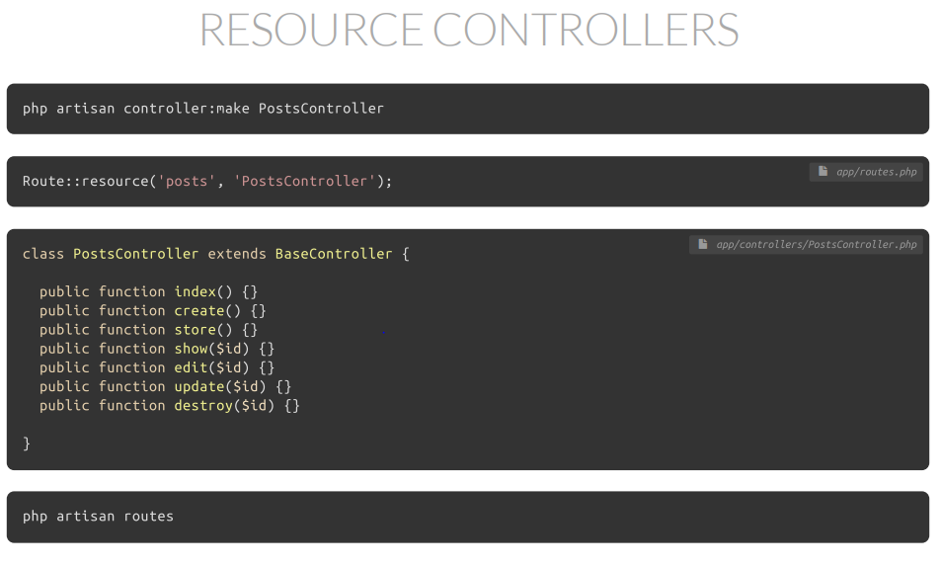
Controllers

Slide 15
Views

Slide 16
Blade
Blade is the simple, yet powerful templating engine provided with Laravel. Unlike other popular PHP templating engines, Blade does not restrict you from using plain PHP code in your views. In fact, all Blade views are compiled into plain PHP code and cached until they are modified, meaning Blade adds essentially zero overhead to your application. Blade view files use the .blade.php file extension and are typically stored in the resources/views directory.

Slide 17
Blade

Slide 18
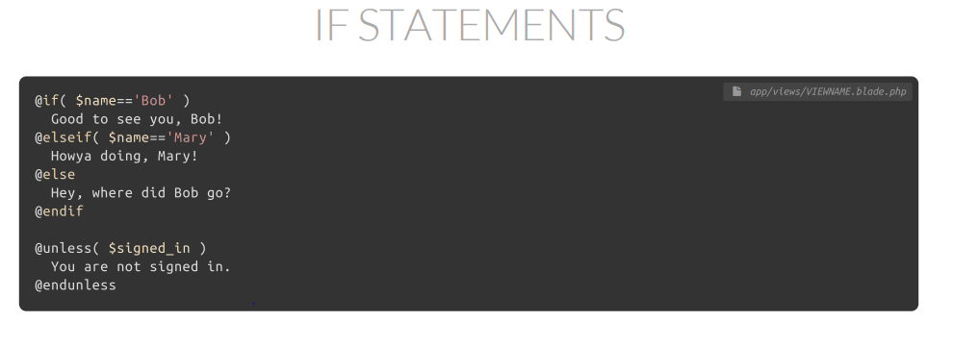
Blade

Slide 19
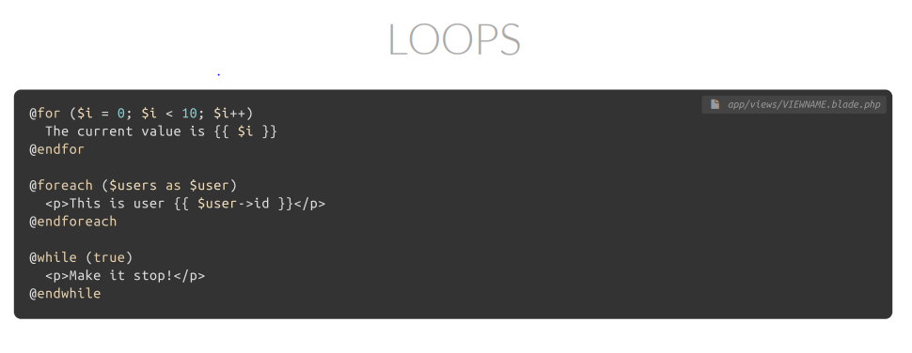
Blade

Slide 20
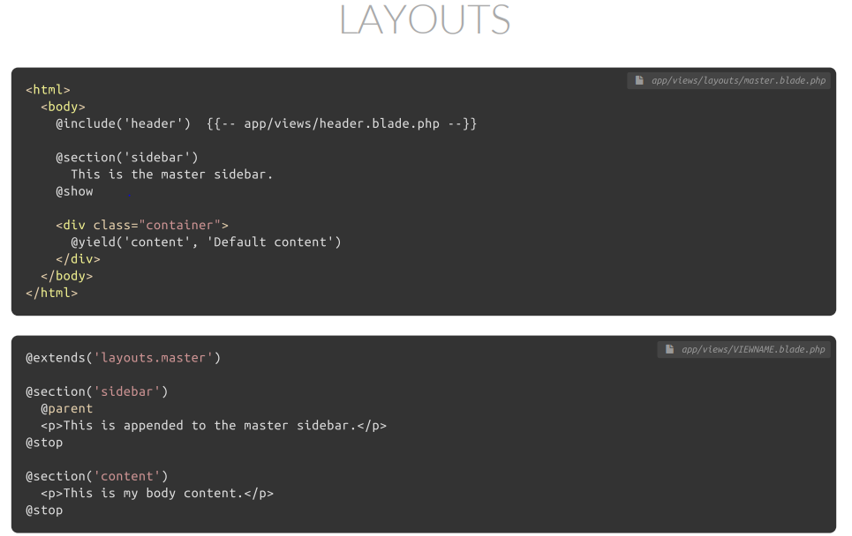
Blade

Slide 21
Databases
Supported Databases
MySQL
PostgresSQL
SQLite
SQL Server

Slide 22
Databases

Slide 23
Databases

Slide 24
Databases
There are 2 important engines in Laravel to handle the databases
Eloquent ORM
Fluent Query Builder

Slide 25
Databases

Slide 26
Databases

Slide 27
Databases

Slide 28
Form Handling

Slide 29
Form Handling

Slide 30
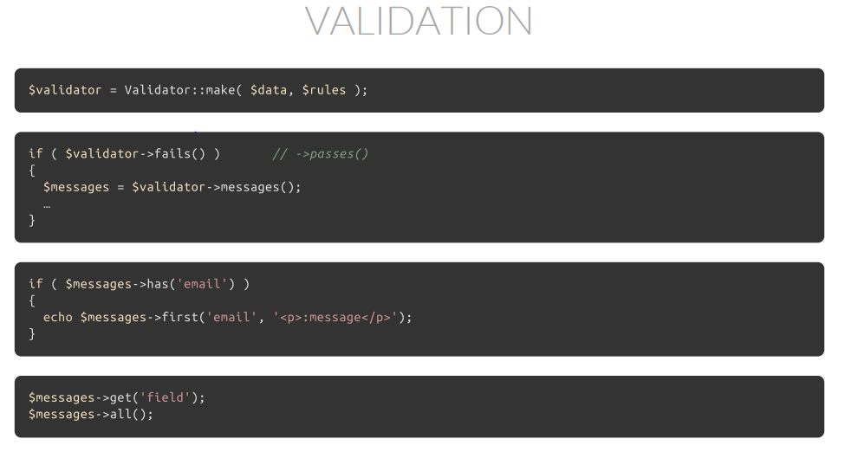
Form Handling

